Slide 1
HKU Mathematics
Rambling in Maths
The Mathematical Key
to unlocking the mysteries
of Cryptography
Dr. Ben Kane
24 March, 2018

Slide 2
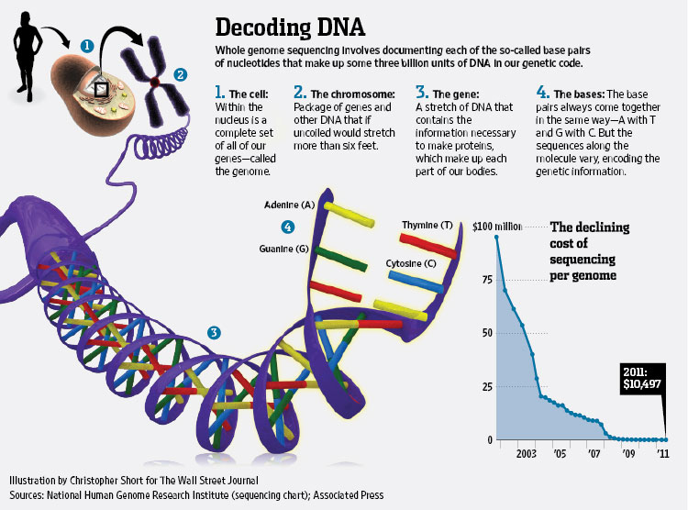
A Problem
You want to do a BIG calculation, e.g. with (LOTS of) DNA data (數據)
Looking for patterns (can save lives!)
Your computer is slow…
Share the work?
Problem: Is it ethical to send?

Slide 3
Cloud Computing: Basic idea
Send the data to the “cloud”
Cloud does some calculations
Answers come back; combine answers centrally

Slide 4
A Concern
Privacy issues (can you trust others?)
Proposal: Can we find a way to have them do the calculations, but never see the data?
We could “mess” with the data
Can they still do calculations?

Slide 5
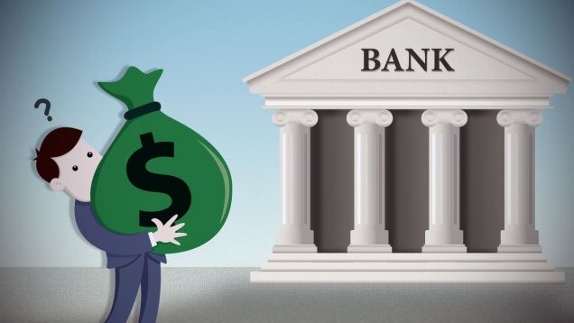
Another Problem
An authority (bank) keeps track of/protects money.
Online cryptocurrency (e.g. Bitcoin): Shared protection, decentralized.

Slide 6
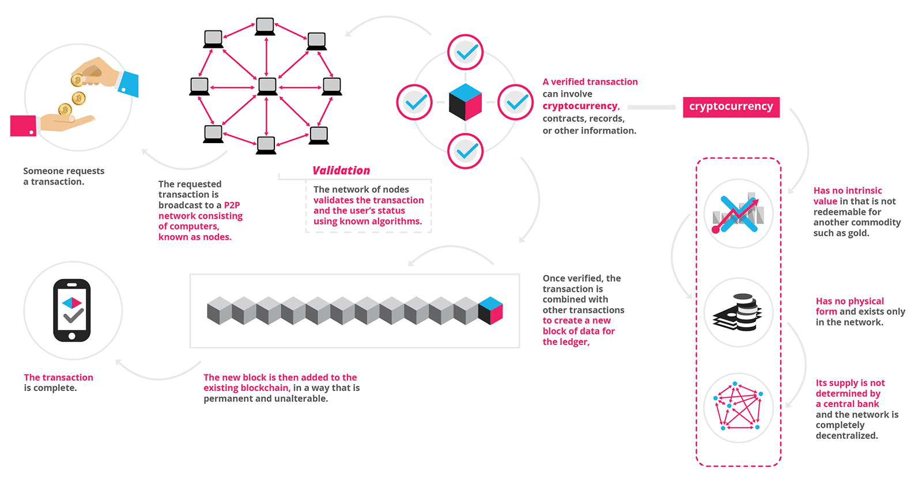
Bitcoin and Blockchain
Transaction made
Collectively agree
Added to “chain”
Cannot be reverted
Important that it is secure (cryptography)
Credit: Amir Rosic, Blockgeeks.com

Slide 7
Encryption
Problems:
Can we send data safely? (我們可以安全發送數據馬?)
Is someone listening?
Is the receiver trusted?
If the data is safely sent …
Can they do calculations? Is it accurate? (計算可以做嗎?)
Can they figure out/guess the original data?
When the data comes back… (當數據發送回來…)
Can we get back the answer and/or original info?
Is it the same as if we did it ourselves? Is it really faster?

Slide 8
Fundamental Rule of Encryption
Can we scramble it?
Idea of (modern) Encryption (加密的想法):
Find problem
That is hard to solve,
easy to check.
We’ll see some examples later.

Slide 9
Back to the beginning…
Goal: Send an important message
Problem: Trust your courier? Man in the middle?

Slide 10
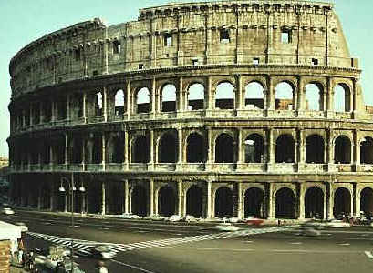
A long time ago…

Slide 11
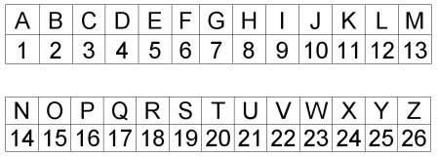
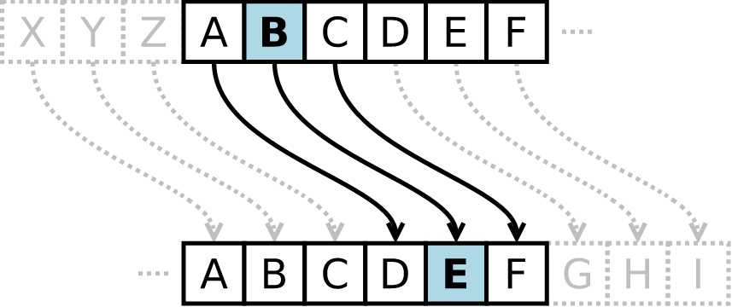
Caesar’s solution
Caesar Cipher: Every letter gets a number
Shift with modular (clock) arithmetic:

Slide 12
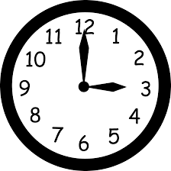
Modular arithmetic
On a clock, the times 3am and 3pm agree.
Some call it 03:00 and 15:00.
So we “pretend” that 3 and 15 are the same.
Our day is a 24 hour repeating clock.
Repeating after 26?

Slide 13
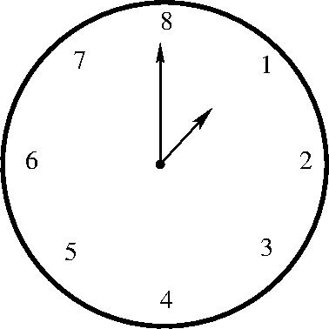
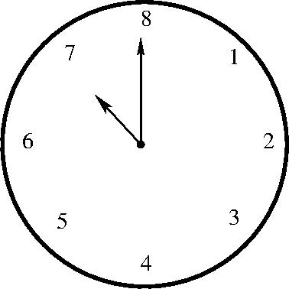
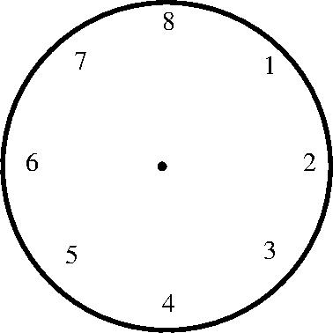
Modular arithmetic
Example:
Let’s consider a clock with 8 hours.
If you start a class at 7 o’clock and it runs for 2 hours, what time will it say on the clock at the end? Try yourself…
7+2=9, so …
It says 1 o’clock.
We write $7+2≡1 \left(mod 8\right)$.

Slide 14
Modular arithmetic
Another example:
Every non-leap year has 365 days.
If your birthday was on Wednesday last year, what day will it be this year (not a leap year)?
Day of week repeats every 7 days (“7-day clock”)
$364=52×7$ (“clock rotates” 52 times)
Remainder 1, so …
Thursday

Slide 15
Some exercises
Find $0≤x<2$ if $12≡x \left(mod 2\right)$.
Find $0≤x<11$ if $46≡x \left(mod 11\right)$.
Find $0≤x<7$ if $82≡2x \left(mod 7\right)$.

Slide 16
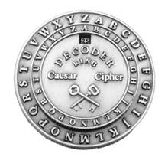
Caesar’s solution
Example: Shift by 10 (spaces removed?):
Secret message: attack at midnight
Number code: 1(20)(20)13(11) 1(20) (13)93(14)978(20)
Caesar sends: kddkmu kd wsnxsqrd
Unscrambled at other end:

Slide 17
Caesar’s solution
Example: Shift by 20
Secret message: Hi
Number code: 89
Add 20: (28)(29)
You send (try yourself): …
You send: bc
(“Clock” has 26 hours)

Slide 18
Exercise
Break Caesar’s code to find the secret message! The encrypted message is “clxmwtyr ty xlesd”.
Luckily, as a loyal attendee, you get the secret decoder information! Thanks for coming!
The shift is 11.

Slide 19
Problem
What if someone figures out the code?
Someone steals: lddlnu ld wsnxsqrd
Simple to reverse.
Look for patterns/ make guesses: (many ‘d’ in code, ‘t’ and ‘e’ common in English)
Other options: Instead of shift, maybe just replace?
Still many letters are common. Hmm…
Is there a better code?

Slide 20
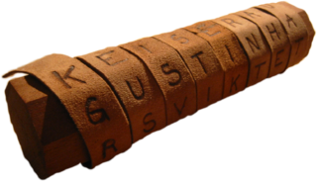
Another try
Maybe try randomly sending {a,…,z}to{a,…,z}?
Spartan army:
Common letters still a problem.

Slide 21
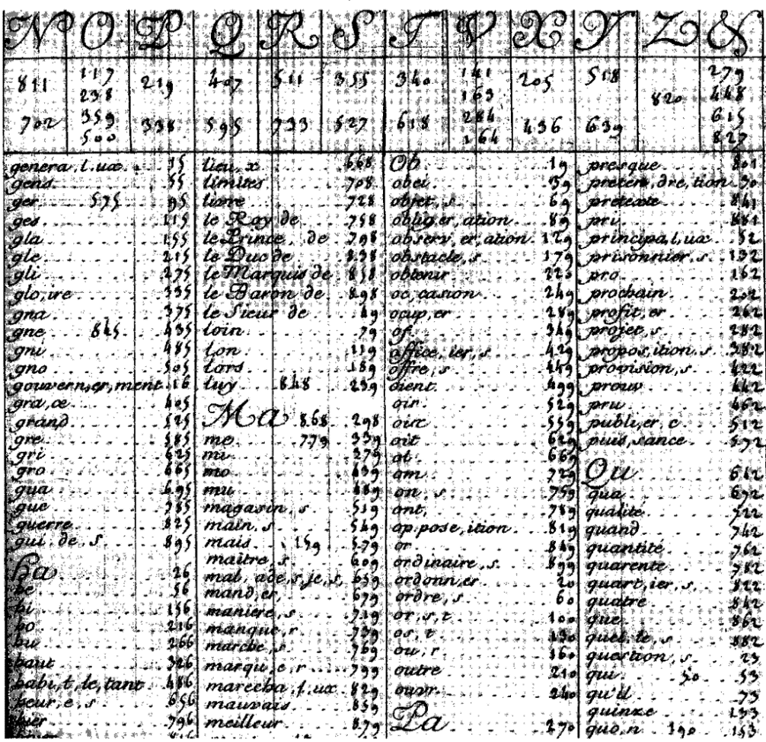
A whole new world /
alphabet

Slide 22
Non-unique replacement
Maybe try randomly sending {a,…,z}to{a,…,z}?
Replace ‘a’ with multiple choices
‘a’ $→$ ‘b’, ‘c’, ‘d’
‘b’ $→$ ‘b’, ‘e’, ‘f’
Example: Great Cipher/Grand Chiffre
Replace syllables with similar-sounding choices
Unbroken for long time
Does ‘a’ always need to go to ‘t’?

Slide 23
Non-unique replacement
Why is it better?
A lot more choices
Frequency counting harder (‘e’ common in French)
Problems?
Need to figure out how/when to switch
Indicator of switch might make it less secure
Example: Capital letters for language switch
Regular switching also can be detected

Slide 24
Polycipher
Example: Take different shifts.
Shift 3, then 11, then 5, then 3, then 11, then 5, then …
Input: “Here is a message”
Take out spaces/capitals: “hereisamessage”
Shift: ‘h’+3 = ‘k’, ‘e’+11=‘p’, ‘r’+5 =‘w’… :
Output: “kpwhtxdxjvdfjp”
Can still find patterns of repeated strings:
“the” appears a lot if you have many phrases.

Slide 25
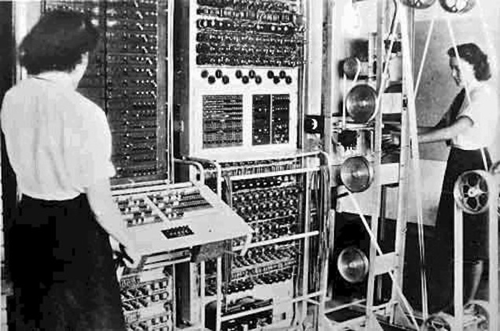
A new challenge…

Slide 26
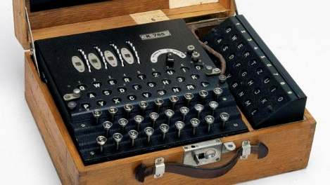
Non-unique replacement, large numbers
Try to increase number of choices? (增加選擇)
Example: Enigma machine
Rotates, so ‘aaaa’ can become ‘rfgw’ (轉子旋轉了→不同的字母出來了)

Slide 27
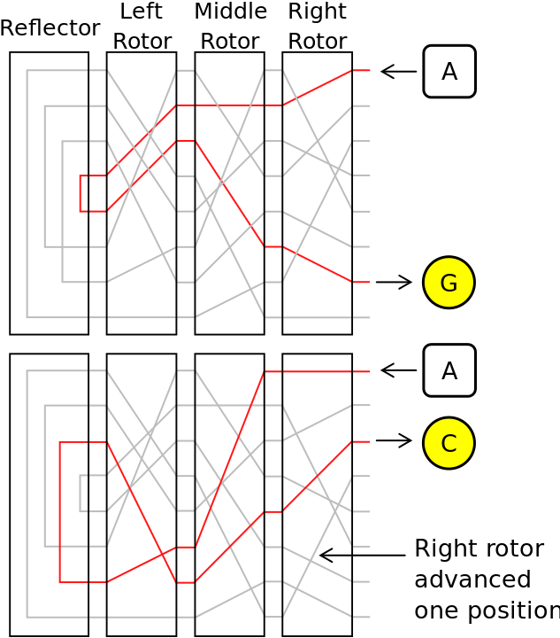
Enigma
Plugboard: Fixed matching (‘a’ to ‘t’)
First rotor (‘a’ to ‘x’), second rotor (‘x’ to ‘r’), third rotor (‘r’ to ‘d’).
Reflector (‘d’ to ‘l’),
Rotors (‘l’ to ‘z’ to ‘b’ to ‘m’)
Output is ‘m’.
Right rotator turns (add with carry)

Slide 28
Enigma Decryption
Process reverses itself:
If rotor sends ‘d’ to ‘x’, then it sends ‘x’ to ‘d’.
Gives extra symmetry (like a mirror)
Key observation: If reflector sends ‘d’ to ‘d’, then message comes back unchanged.
Designed never to send ‘a’ to ‘a’
Reduces total number of possibilities (a lot)

Slide 29
Downfall of Enigma
Number of permutations (reorderings) of 26 letters: $26!≈4.0×{10}^{26}$
Number of permutations of 26 letters, none repeated:
25 choices for ‘a’, 24 choices for ‘b’, …, overall: $25!≈1.5×{10}^{25}$
Other symmetries help, too. (a matched to b is b matched to a, etc.)
Common signals helped.

Slide 30
A big jump forward…

Slide 31
Computer age
Computer search not expected (沒預料到電腦)
Computers search differently
Naïve search still often not enough
Algorithm designs, search for weakenesses
Beginnings/foundations of computer science
Eventually split off of math departments
Something new needed for cryptography

Slide 32
One-Way Functions
Idea: What if there is an operation which is easy to do, but hard to reverse?做簡單, 顛倒計算很難
Doing the operation is encryption, and reversing it is decryption.
Authorized people know a secret that allows reversal.
Example:
Multiply 3571 and 6997 to get 24986287.
Given 24986287, can you find 3571 and 6997?

Slide 33
Prime Factorization and RSA
Question: Given an integer, can you find all of its factors (those integers which divide it equally)?
Prime numbers are those whose only factors are 1 and themselves. (素數)
Break a number up into primes (try to divide by 2, then 3, then 5, …): Prime factorization.
RSA core idea: Multiplying primes is fast/easy, prime factoring is slow/hard.
Can you even find all possible primes?

Slide 34
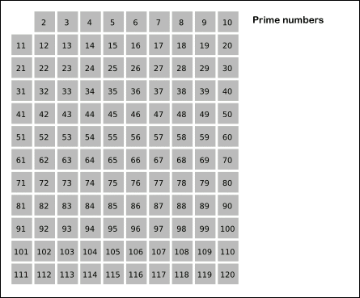
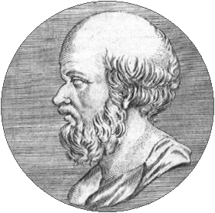
Prime numbers
Sieve of Eratosthenes (Greece, c. 276BC – 195BC):
"Sieve of Eratosthenes animation". Licensed under CC BY-SA 3.0 via Wikimedia Commons

Slide 35
Prime Factorization
Example: Consider 144
Even: Divide by 2: now $2×72$.
Even: Divide by 2: now $2^{2}×36$.
Even: Divide by 2: …
…
Eventually get: $2^{4}×9=2^{4}×3^{2}.$

Slide 36
Prime Factorization
Example: Consider 481
Not Even: … Try 3
$481÷3$: Remainder 1. No. Try 5
$481÷5$: Remainder 1. No. Try 7
$481÷7$: Remainder 5. No. Try 11
$481÷11$: Remainder 8. No. Try 13
$481÷13=37$: $481=13×37$

Slide 37
Prime Factorization
What about bigger numbers?
Try 132523411?
Not 2, not 3, not 5, not 7, …,
…, 1039 divides!
$$132523411=1039×127549$$
Q: Is 127549 prime?

Slide 38
RSA
Problem: Relatively slow if primes are big.
Basic algorithm:
Pick 2 large primes.
Multiply them together and give answer to others.
Others use this as “public key” to encrypt information
You know secret primes (“private key”).

Slide 39
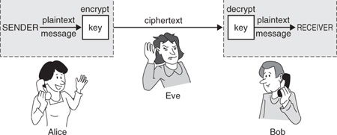
Passing of messages
Alice wants to send Bob a message.
Alice knows Bob’s public key (everyone does)
Alice encrypts/locks information with public key
Bob uses the private key to decrypt/unlock
People in middle can see message, but it is locked

Slide 40
RSA details
Encryption:
Turn message M into number $m$ (e.g., ‘a’=1, ‘b’=2,…)
Public key is $e$ and some (special) number N
Compute ${c=m}^{e}(mod N)$
Here “$mod N$” means $r$ equals $N+r$(clock arithmetic)
Answer $c$ is sent
“Special” $N$ and secret $d$ satisfy: ${m=m}^{de}(mod N)$

Slide 41
RSA details
Further details:
$N$ is product of two primes
$e$ is (basically) random
Given $e$ and primes, can compute $d$
Uses Fermat’s little Theorem: If p is prime, then $m^{p}=m\left(mod p\right)$
Decrypt: Take $c^{d}=m^{ed}=m(mod N)$
Security: Not easy to find $d$ from $e$ and $N$.

Slide 42
RSA Example
Primes $17$ and $13$.
Product is $N=17×13=221$
Fermat’s little Theorem:
$m^{16}=1\left(mod 17\right)$
$m^{12}=1(mod 13)$
1 times 1 is 1 (also works with modular arith.), so
$m^{48}={\left(m^{16}\right)}^{3}=1 (mod 17)$
$m^{48}={\left(m^{12}\right)}^{4}=1 (mod 13)$
$m^{48}=1 (mod 17×13)$

Slide 43
RSA Example
Choose say $e=11$
Want $de=1 (mod 48)$
Solve:
$d=3 (mod 16)$ (so $d=3$, $d=19$, or $d=35$),
$d=2 (mod 3)$ (so $d=35$)
Message $m=12<221$
${12}^{11}=743008370688=142 (mod 221)$
${142}^{35}=…=12 (mod 221)$

Slide 44
Other one-way functions
Another choice: ECC (elliptic curve cryptography)
Elliptic curve is solutions to ($f\left(x\right)$ poly. degree 3) $C: y^{2}=f\left(x\right)$
Example: ${C: y}^{2}=x^{3}−x$
Points $\left(x,y\right)$ on curve: (0,0), (1,0), (-1,0), $\left(2,\sqrt{6}\right)$, $\left(2,−\sqrt{6}\right)$, …

Slide 45
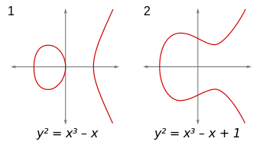
Elliptic curves
Can graph the solutions:
Between two points, there is a unique line
Connects to one other point on the curve
By GYassineMrabetTalk CC BY-SA 3.0,

Slide 46
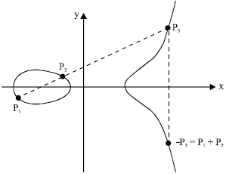
Elliptic curves: Addition (加法)
Addition on points:
Between two points, there is a unique line
Connects to one other point on the line
Rotate around $x$-axis:
Extra point “at infinity”
Vertical lines add to infinity
Infinity like zero ${(0}_{c})$
Why?

Slide 47
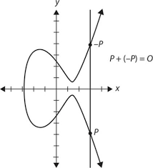
Elliptic curves: Addition and zero
Addition with “infinity” :
Line between $P=(x,y)$ and infinity vertical
Other point on line is $(x,−y)$
Rotate around $x$-axis:
Gives $\left(x,y\right)=P!$
So adding infinity does nothing
Just like zero in addition!

Slide 48
Elliptic Curves: Addition
Example:
Curve: $C: y^{2}=x^{3}+x−1$
Points $\left(1,1\right), (2,3)$
Line between points:
slope = $\frac{3−1}{2−1}=2,$
$y=2x+b→1=2\left(1\right)+b→y=2x−1$
Both equations at same time: ${\left(2x−1\right)}^{2}=x^{3}+x−1→x^{3}−4x^{2}+5x−2=0$ ${\left(x−1\right)}^{2}\left(x−2\right)=0$

Slide 49
Elliptic Curves: Addition
Overall: $\left(1,1\right)+_{C}\left(2,3\right)=(1,−1)$
Minus: flip over $x$-axis: ${\left(1,1\right)+}_{c}\left(1,−1\right)=0_{c}$.
So define $−_{C}\left(1,1\right)≔(1,−1)$
Given a point $P$, can we compute $2_{C}P=P+_{C}P, 3_{C}P=P+_{C}P+_{C}P, …?$
Remember example: $\left(1,1\right)+_{C}\left(2,3\right)=−_{C}(1,1)$, $2_{C}\left(1,1\right)=−_{C}\left(2,3\right)=(2,−3)$

Slide 50
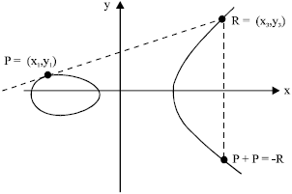
Elliptic Curves: Addition
Geometric interpretation of $2_{C}P$?
Line with point and itself?
Tangent line:
Kefa Rabah, Theory and Implementation of Elliptic Curve Cryptography, Journal of Applied Sciences 5 (2005), 604-633.

Slide 51
Elliptic Curves: Addition
Example: Find $3_{c}(1,1)$
Curve: $C: y^{2}=x^{3}+x−1$
Points $\left(1,1\right), \left(2,−3\right)=2_{c}(1,1)$
Line between points:
slope = $\frac{−3−1}{2−1}=−4,$
$y=−4x+b→1=−4\left(1\right)+b→y=−4x+5$
Both equations at same time: ${\left(−4x+5\right)}^{2}=x^{3}+x−1→$ $x^{3}−16x^{2}+41x−26=0$ $→(x−1)\left(x−2\right)(x−13)=0$

Slide 52
Elliptic Curves: Addition
Overall: $3_{C}\left(1,1\right)=\left(1,1\right)+_{C}\left(2,−3\right)=(13,−47)$
Can continue like this …
Find $4_{C}\left(1,1\right), 5_{C}\left(1,1\right), …$ Elliptic curve 的乘法.
Easy to teach a computer to repeat the process!
Question: How fast is calculation of ${100}_{C}\left(1,1\right)$?

Slide 53
Elliptic Curves: Fast Addition
Add 100 times (100 sums, kind of slow)
But … Can easily double: $2_{C}\left(1,1\right)+_{C}2_{C}\left(1,1\right)=4_{C}\left(1,1\right)$ $4_{C}\left(1,1\right)+_{C}4_{C}\left(1,1\right)=8_{C}\left(1,1\right)$ $⋮$
Compute ${100}_{C}\left(1,1\right)={64}_{C}\left(1,1\right)+{32}_{C}\left(1,1\right)+4_{C}(1,1)$
Only double 6 times to get 64… 8 sums!

Slide 54
Binary numbers to the rescue
Can write number in binary: $abcd_{2}=a×2^{3}+b×2^{2}+c×2^{1}+d×2^{0}$
So ${1011}_{2}=2^{3}+2+1=11$
For ${\left(2^{n}\right)}_{C}\left(1,1\right)$, only need to double $n$ times
Note that $10$ is a lot less than $2^{10}=1024$
Many less calculations, so faster

Slide 55
Elliptic curve cryptography
One way function?
Given ${1000}_{C}P$, can you find $P$?
Easy in one way, seemingly hard in the other way
Advantages/disadvantages of ECC:
Adv.: Smaller keys generally, fast to create
Dis.: Complicated to implement
Used in Blockchain.

Slide 56
Key Sharing?
Can we share a key?
Session keys:
If I send you my key:
others can see it
Someone steals your message, replaces with own
Send you my key, encrypted with your public key
You decrypt with private key
Maybe someone in the middle pretended to be me?
You send back confirmation encrypted with my public key

Slide 57
Back to the future…

Slide 58
Homomorphic Encryption
Suppose you have everyone’s biological data.
You want to compute some statistics/information.
Your computer takes too long.
You need help, but who can you trust?
Idea: What if others could do your calculations, but get no data?
How would you do that? Is it even possible?

Slide 59
Homomorphic Encryption
You give the data $m$ in encrypted form (say $E(m)$)
You want others to be able to add and multiply, but never see $m$.
What if $E\left(m_{1}+m_{2}\right)=E\left(m_{1}\right)+E\left(m_{2}\right),$ $E\left(m_{1}{×m}_{2}\right)=E\left(m_{1}\right)×E\left(m_{2}\right)?$
This is homomorphic Encryption.

Slide 60
Partial Homomorphic Encryption
Is homomorphic cryptography possible? Do we know some examples?
Caesar (shift by 1): $E\left(m_{1}+m_{2}\right)=m_{1}+m_{2}+1,$ $E\left(m_{1}+m_{2}\right)=m_{1}+1+m_{2}+1,$ $E\left(m_{1}×m_{2}\right)=m_{1}×m_{2}+1$ $E\left(m_{1}\right)×E\left(m_{2}\right)=\left(m_{1}+1\right)×(m_{2}+1)$
Some methods partially work:
RSA: $E\left(m_{1}×m_{2}\right)=E(m_{1})×E(m_{2})$

Slide 61
Homomorphic Encryption
There are some rules …
Needs to be safe …
Can‘t guess based on saving lots of encrypted messages
In particular, everything is zeros/ones
So can’t guess what is zero.
A problem: $E\left(m\right)=E\left(m+0\right)=E\left(m\right)+E\left(0\right)$ $→E\left(0\right)=0$

Slide 62
Homomorphic Encryption
Seems impossible to “hide” zero.
Can it be “mostly true”?
If “mostly true”, is the answer accurate?
Should we give up?

Slide 63
Somewhat homomorphic encryption
Gentry (2009): Added some “noise” so that encryption is almost homomorphic.
Is it accurate?
Noise is “small” compared to main answer
Allows many additions/multiplications
Builds off of this to get homomorphic encryption:
Noise cancellation method
Takes a lot of operations, though

Slide 64
Homomorphic Encryption
A trick:
Is zero really zero?
12 o’clock is midnight, but also noon.
What if someone doesn’t know # hours on clock?
We pick a number of hours, but don’t tell anyone!
They read 26 o’clock, but don’t know the “real time”
Pass info one way …
Interpret the info differently yourself …

Slide 65
Homomorphic Encryption
Now we have “a lot of zeros”
0 is zero
12 is zero
24 is zero
36 is zero
…
Problem: Pattern too simple
Can be guessed
Not safe

Slide 66
Homomorphic Encryption
Need to combine with other ideas
Pass some data…
Do something …
Get a value (secret)
Now apply modular arithmetic (secret)
Need to make sure others can’t compute value
Otherwise they can guess pattern in modular arith.
Starts to fall apart piece-by-piece
Some new ideas out there …

