Slide 1
Gaussian Channels with Feedback
Shunsuke IHARA
Nagoya Univ.
August 19, 2019

Slide 2
Contents
1. Gaussian channel
2. Feedback capacity
3. ARMA noise channel
4. MA (1) noise channel
5. Asymptotic behavior of error probability
6. Continuous-time Gaussian channel

Slide 3
Preface
We consider the discrete-time additive Gaussian noise channels under average power constraint. We are concerning the feedback capacity of the channels. Despite numerous lower and upper bounds have been reported, except some special cases, the closed-form for the feedback capacity is not known.
In this talk, we focus on the case where the additive Gaussian noise is a first-order moving average (MA (1)) process. For this channel, Kim (2006, 2010) obtained the closed-form of the feedback capacity and the optimal coding scheme by which the channel capacity is achieved. The main aim of the talk is to give a new proof of the optimality of the coding scheme given by Kim.
We also discuss on the asymptotic behavior of error probability.

Slide 4
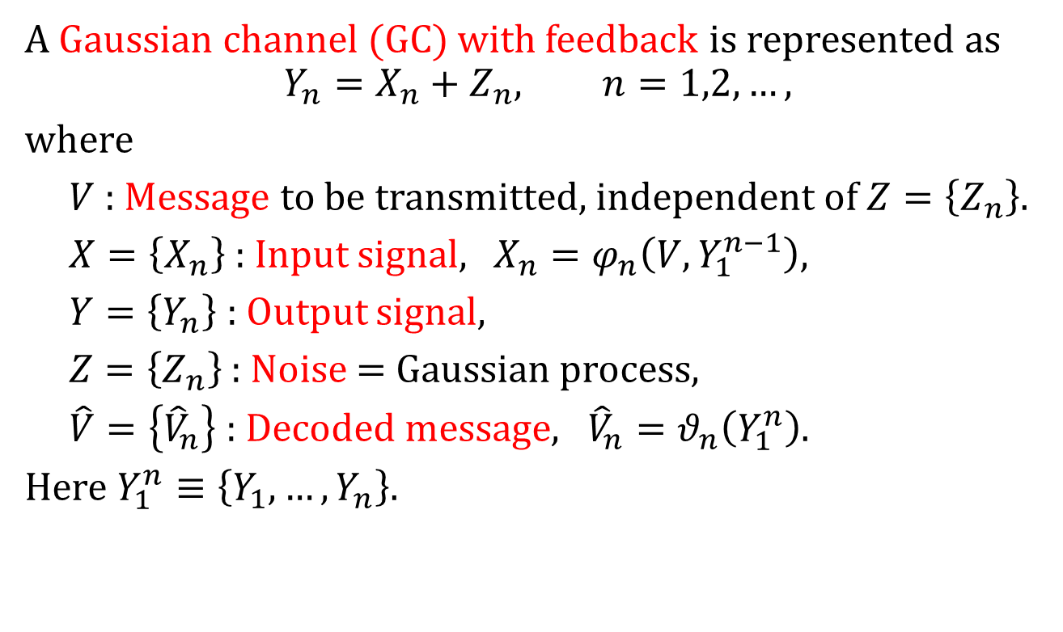
1. Gaussian channel
A Gaussian channel (GC) with feedback is represented as
$$Y_{n}=X_{n}+Z_{n}, n=1,2,…,$$
where
$V$ : Message to be transmitted, independent of $Z=\left\{Z_{n}\right\}.$
$X=\left\{X_{n}\right\}$ : Input signal, $X_{n}=φ_{n}\left(V,Y_{1}^{n−1}\right)$,
$Y=\left\{Y_{n}\right\}$ : Output signal,
$Z=\left\{Z_{n}\right\}$ : Noise = Gaussian process,
$\hat{V}=\left\{{\hat{V}}_{n}\right\}$ : Decoded message, ${\hat{V}}_{n}=θ_{n}\left(Y_{1}^{n}\right)$.
Here $Y_{1}^{n}≡\left\{Y_{1},…,Y_{n}\right\}$.

Slide 5
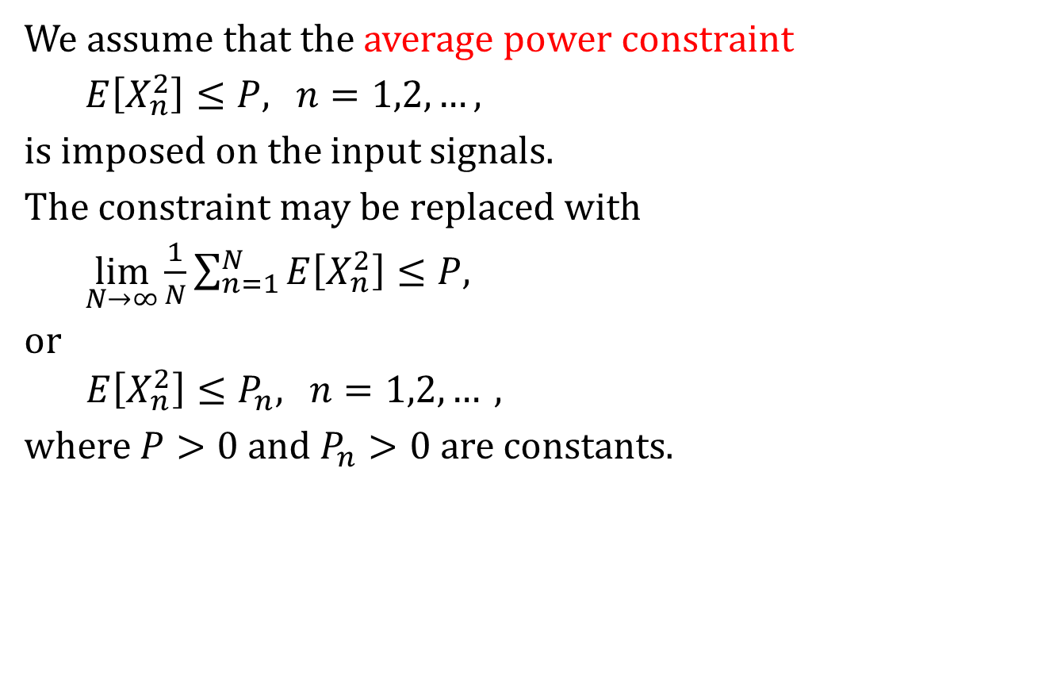
Average power constraint
We assume that the average power constraint
$E\left[X_{n}^{2}\right]≤P$,$n=1,2,…,$
is imposed on the input signals.
The constraint may be replaced with
$\lim_{N→∞}{\frac{1}{N}\sum_{n=1}^{N}{E\left[X_{n}^{2}\right]≤P,}}$
or
  $E\left[X_{n}^{2}\right]≤P_{n},$ $n=1,2,…,$
where $P>0$ and $P_{n}>0$ are constants.

Slide 6
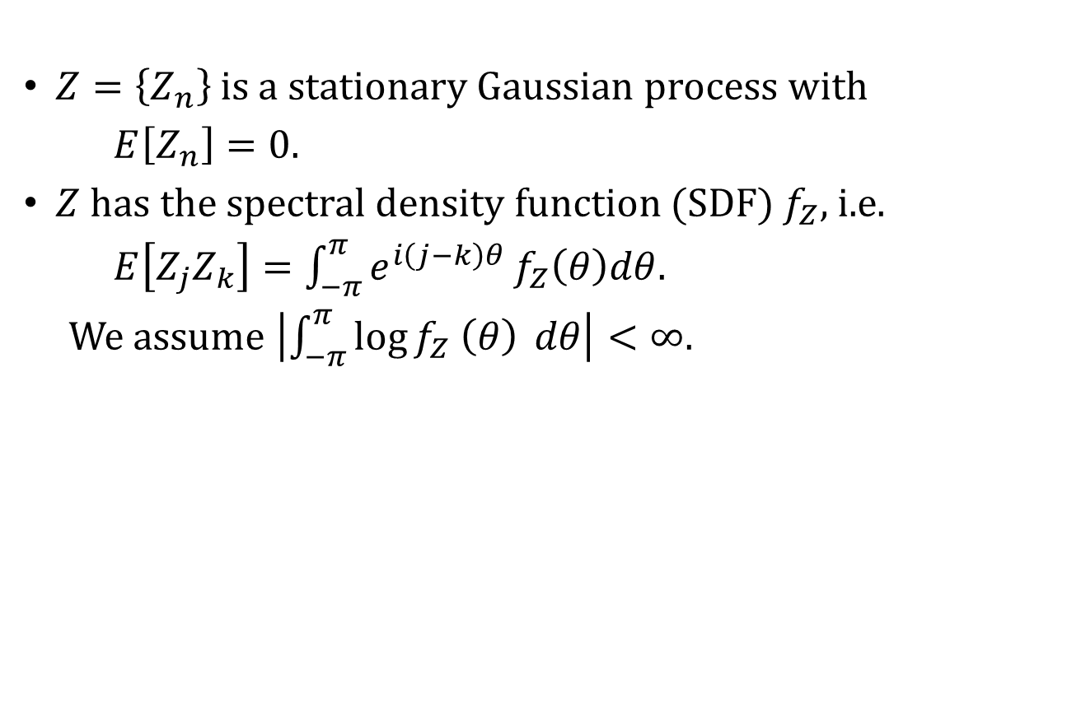
Assumptions on the noise $Z=\left\{Z_{n}\right\}$
$Z=\left\{Z_{n}\right\}$ is a stationary Gaussian process with
$E\left[Z_{n}\right]=0.$
$Z$has the spectral density function (SDF) $f_{Z},$ i.e.
$E\left[Z_{j}Z_{k}\right]=\int_{−π}^{π}{e^{i\left(j−k\right)θ}}f_{Z}\left(θ\right)dθ.$
We assume $\left|\int_{−π}^{π}{\log{f_{Z} \left(θ\right)}} dθ\right|<∞$.

Slide 7
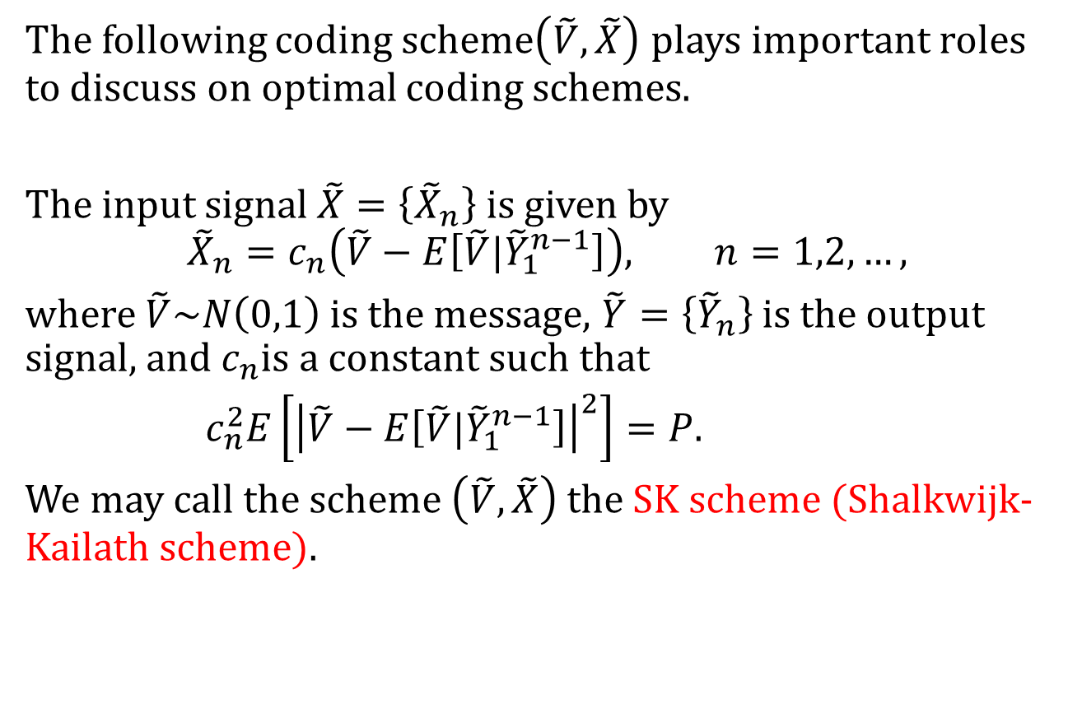
SK scheme
The following coding scheme$\left(\tilde{V},\tilde{X}\right)$ plays important roles to discuss on optimal coding schemes.
The input signal $\tilde{X}=\left\{{\tilde{X}}_{n}\right\}$is given by
$${\tilde{X}}_{n}=c_{n}\left(\tilde{V}−E\left[\tilde{V}|{\tilde{Y}}_{1}^{n−1}\right]\right), n=1,2,…,$$
where $\tilde{V}\sim N\left(0,1\right)$is the message, $\tilde{Y}=\left\{{\tilde{Y}}_{n}\right\}$ is the output signal, and $c_{n}$is a constant such that
$c_{n}^{2}E\left[{\left|\tilde{V}−E\left[\tilde{V}|{\tilde{Y}}_{1}^{n−1}\right]\right|}^{2}\right]=P.$
We may call the scheme $\left(\tilde{V},\tilde{X}\right)$the SK scheme (Shalkwijk-Kailath scheme).

Slide 8
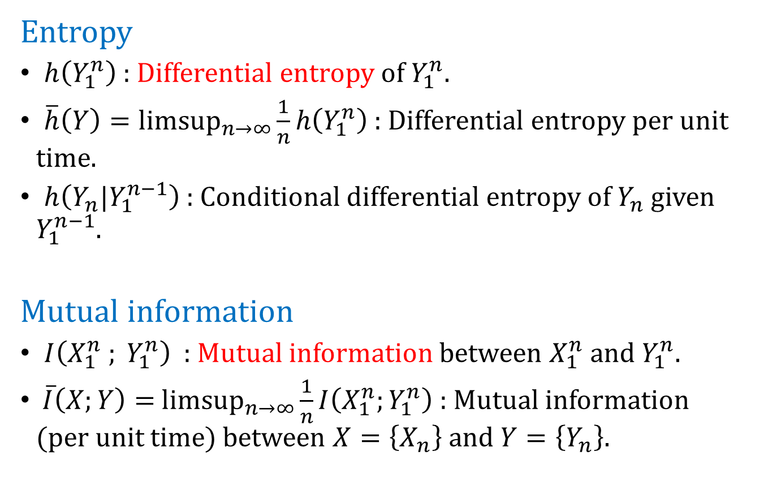
Entropy and mutual information
Entropy
$h\left(Y_{1}^{n}\right)$ : Differential entropy of $Y_{1}^{n}$.
$\overline{h}\left(Y\right)={limsup}_{n→∞}\frac{1}{n}h\left(Y_{1}^{n}\right)$ : Differential entropy per unit time.
$h\left(Y_{n}|Y_{1}^{n−1}\right)$ : Conditional differential entropy of $Y_{n}$given $Y_{1}^{n−1}$.
Mutual information
$I\left(X_{1}^{n} ; Y_{1}^{n}\right)$ : Mutual information between $X_{1}^{n}$and $Y_{1}^{n}.$
$\overline{I}\left(X;Y\right)=$ ${limsup}_{n→∞}\frac{1}{n}I\left(X_{1}^{n};Y_{1}^{n}\right)$ : Mutual information (per unit time) between $X=\left\{X_{n}\right\}$ and $Y=\left\{Y_{n}\right\}$.

Slide 9
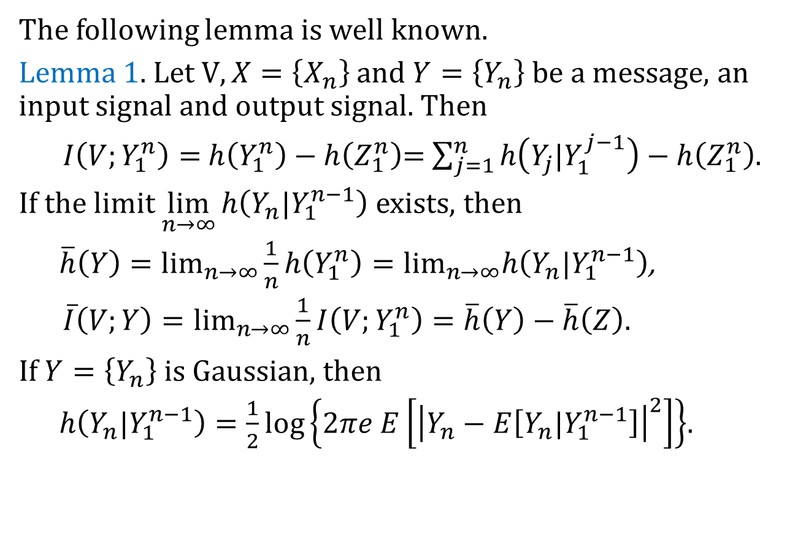
Properties of entropy and mutual information
The following lemma is well known.
Lemma 1. Let $V, X=\left\{X_{n}\right\}$ and $Y=\left\{Y_{n}\right\}$ be a message, an input signal and output signal. Then
$I\left(V;Y_{1}^{n}\right)=$ $h\left(Y_{1}^{n}\right)−h\left(Z_{1}^{n}\right)$= $\sum_{j=1}^{n}{h\left(Y_{j}|Y_{1}^{j−1}\right)}−h\left(Z_{1}^{n}\right)$.
If the limit $\lim_{n→∞}{h\left(Y_{n}|Y_{1}^{n−1}\right)}$ exists, then
$\overline{h}\left(Y\right)=\lim_{n→∞}\frac{1}{n}h\left(Y_{1}^{n}\right)=\lim_{n→∞}h\left(Y_{n}|Y_{1}^{n−1}\right)$,
$\overline{I}\left(V;Y\right)=\lim_{n→∞}\frac{1}{n}I\left(V;Y_{1}^{n}\right)=\overline{h}\left(Y\right)−\overline{h}\left(Z\right).$
If $Y=\left\{Y_{n}\right\}$ is Gaussian, then
$h\left(Y_{n}|Y_{1}^{n−1}\right)=\frac{1}{2}log\left\{2πe E\left[{\left|Y_{n}−E\left[Y_{n}|Y_{1}^{n−1}\right]\right|}^{2}\right]\right\}$.

Slide 10
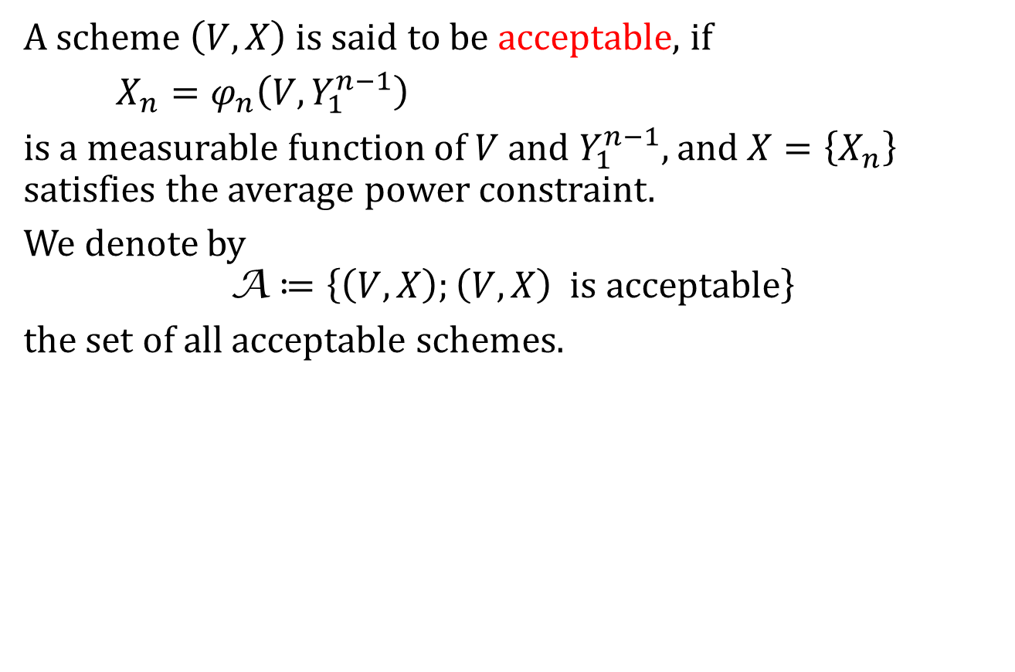
2. Feedback capacity
Acceptable scheme
A scheme $\left(V,X\right)$ is said to be acceptable, if
$X_{n}=φ_{n}\left(V,Y_{1}^{n−1}\right)$
is a measurable function of $V$ and $Y_{1}^{n−1},$ and $X=\left\{X_{n}\right\}$ satisfies the average power constraint.
We denote by
$$\text{A}≔\left\{\left(V,X\right);\left(V,X\right) is acceptable\right\}$$
the set of all acceptable schemes.

Slide 11
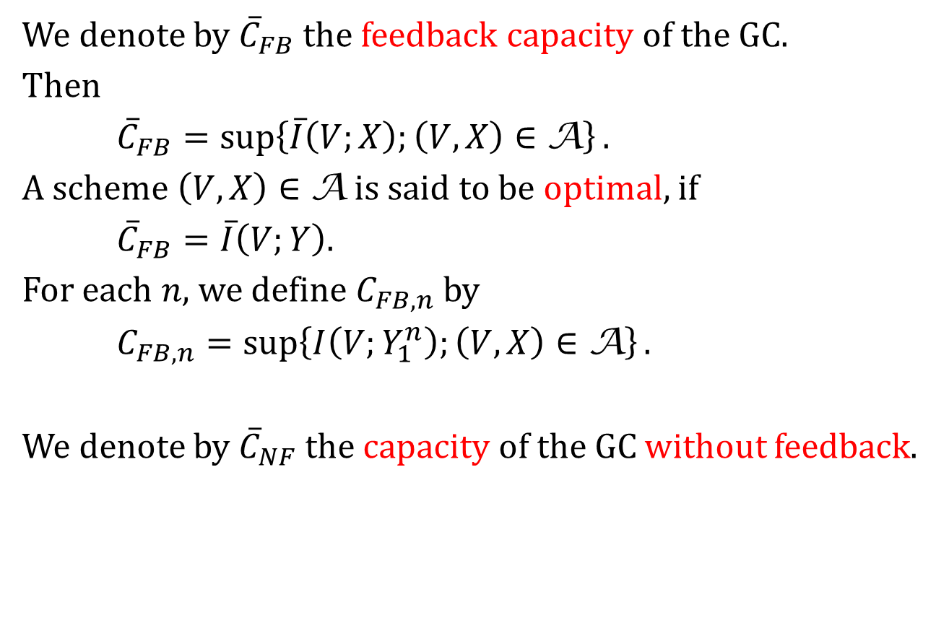
Capacity
We denote by ${\overline{C}}_{FB}$ the feedback capacity of the GC.
Then
${\overline{C}}_{FB}=\sup\left\{\overline{I}\left(V;X\right);\left(V,X\right)∈\text{A}\right\}.$
A scheme $\left(V,X\right)∈\text{A}$ is said to be optimal, if
${\overline{C}}_{FB}=\overline{I}\left(V;Y\right).$
For each $n,$ we define $C_{FB,n}$ by
$C_{FB,n}=\sup\left\{I\left(V;Y_{1}^{n}\right);\left(V,X\right)∈\text{A}\right\}.$
We denote by ${\overline{C}}_{NF}$ the capacity of the GC without feedback.

Slide 12
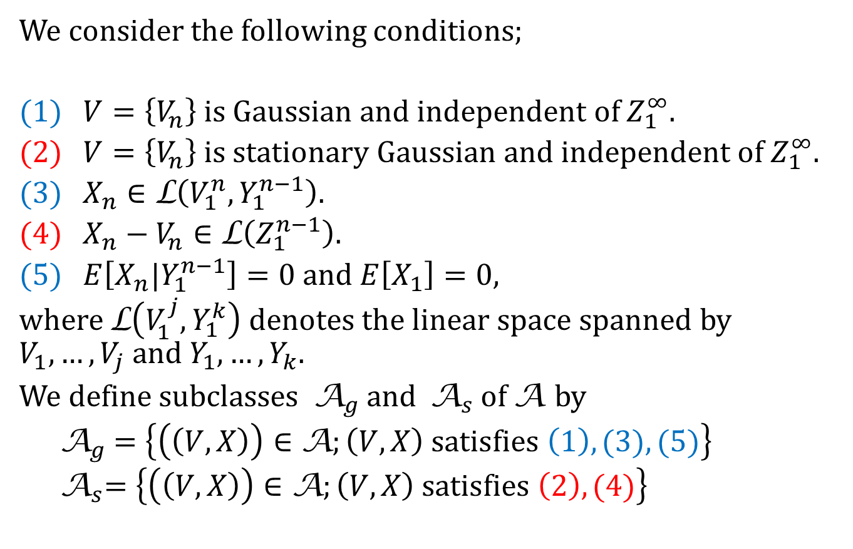
Classes of acceptable schemes
We consider the following conditions;
(1) $V=\left\{V_{n}\right\}$is Gaussian and independent of $Z_{1}^{∞}.$
(2) $V=\left\{V_{n}\right\}$is stationary Gaussian and independent of $Z_{1}^{∞}.$
(3) $X_{n}∈\text{L}\left(V_{1}^{n},Y_{1}^{n−1}\right).$
(4) $X_{n}−V_{n}∈\text{L}\left(Z_{1}^{n−1}\right).$
(5) $E\left[X_{n}|Y_{1}^{n−1}\right]=0$ and $E\left[X_{1}\right]=0,$
where $\text{L}\left(V_{1}^{j},Y_{1}^{k}\right)$denotes the linear space spanned by $V_{1},…,V_{j}$ and $Y_{1},…,Y_{k}.$
We define subclasses ${ \text{A}}_{g}$and ${ \text{A}}_{s}$of A by
${ \text{A}}_{g} =\left\{\left(\left(V,X\right)\right)∈\text{A};\left(V,X\right) satisfies \left(1\right), (3), (5)\right\}$
${ \text{A}}_{s}=\left\{\left(\left(V,X\right)\right)∈\text{A};\left(V,X\right) satisfies \left(2\right), (4)\right\}$

Slide 13
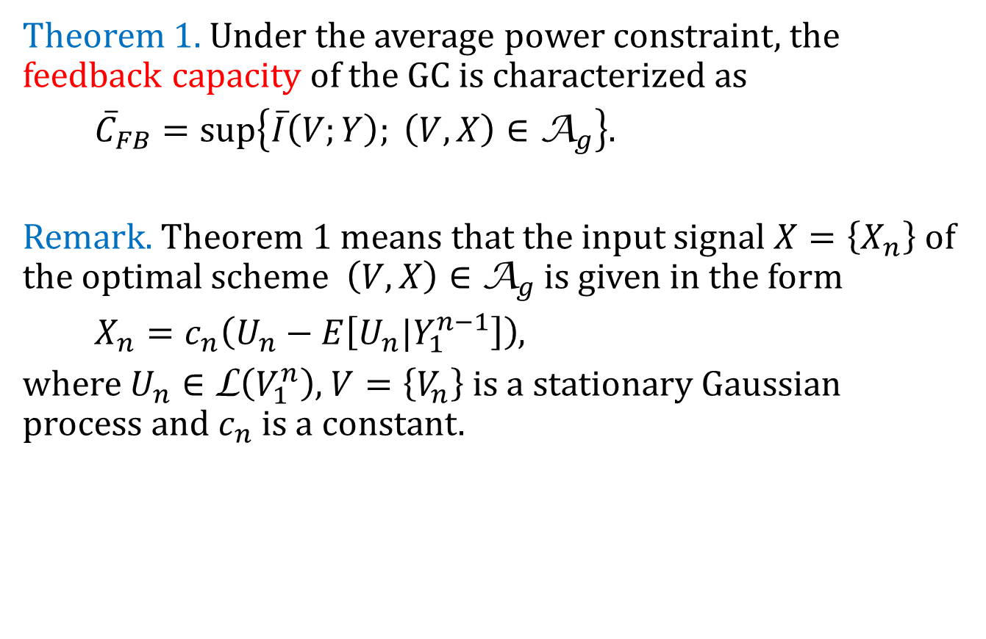
Theorem 1
Theorem 1. Under the average power constraint, the feedback capacity of the GC is characterized as
${\overline{C}}_{FB}=\sup\left\{\overline{I}\left(V;Y\right); \left(V,X\right)∈{\text{A}}_{g}\right\}.$
Remark. Theorem 1 means that the input signal $X=\left\{X_{n}\right\}$of the optimal scheme $\left(V,X\right)∈$ ${\text{A}}_{g}$is given in the form
$X_{n}=c_{n}\left(U_{n}−E\left[U_{n}|Y_{1}^{n−1}\right]\right)$,
where $U_{n}∈\text{L}\left(V_{1}^{n}\right)$, $V=\left\{V_{n}\right\}$is a stationary Gaussian process and $c_{n}$ is a constant.

Slide 14
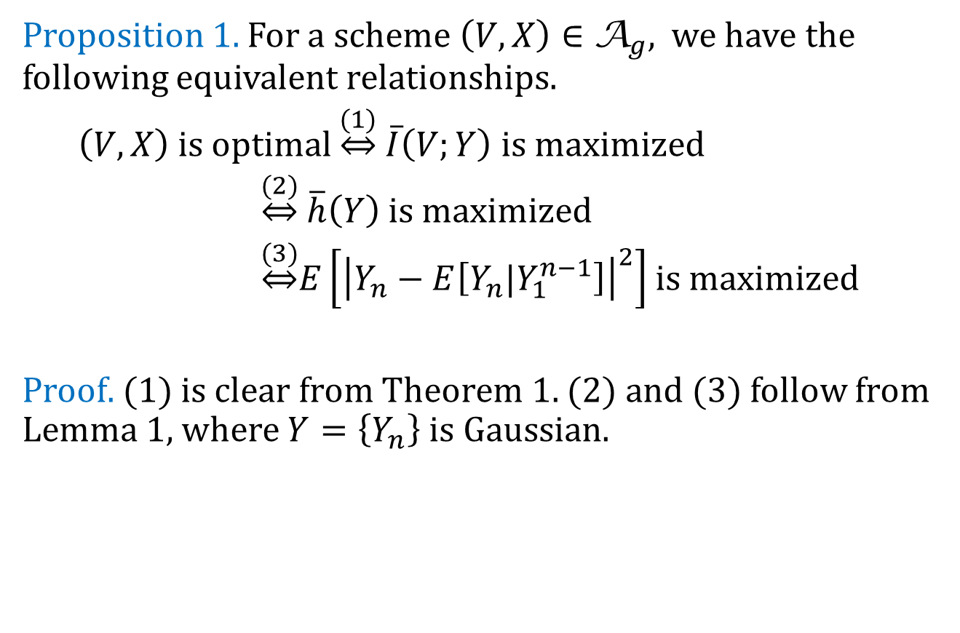
Proposition 1
Proposition 1. For a scheme $\left(V,X\right)∈{\text{A}}_{g},$ we have the following equivalent relationships.
$\left(V,X\right)$is optimal $\underset{⇔}{(1)} \overline{I}\left(V;Y\right)$is maximized
$\underset{⇔}{(2)} \overline{h}\left(Y\right)$is maximized
$\underset{⇔}{(3)}E\left[{\left|Y_{n}−E\left[Y_{n}|Y_{1}^{n−1}\right]\right|}^{2}\right]$ is maximized
Proof. (1) is clear from Theorem 1. (2) and (3) follow from Lemma 1, where $Y=\left\{Y_{n}\right\}$ is Gaussian.

Slide 15
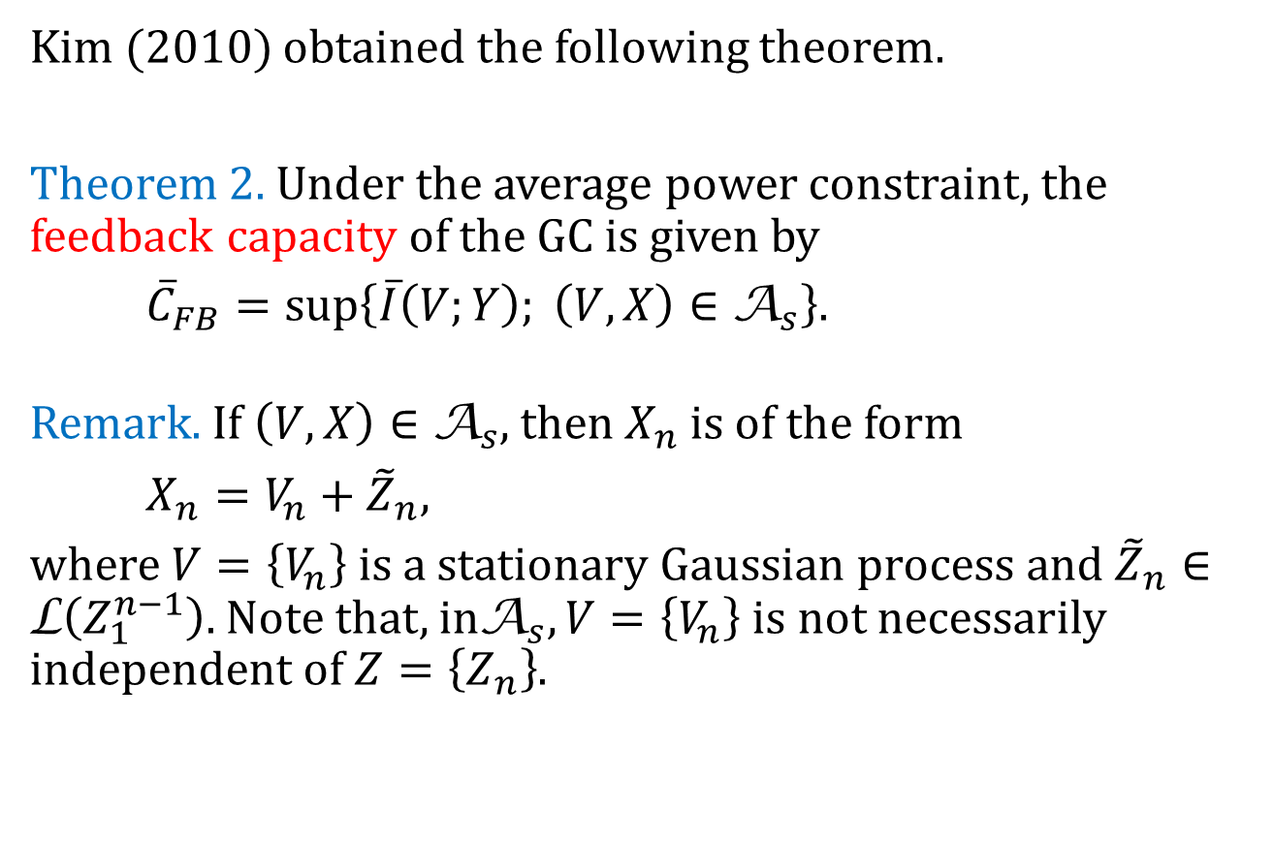
Theorem 2
Kim (2010) obtained the following theorem.
Theorem 2. Under the average power constraint, the feedback capacity of the GC is given by
${\overline{C}}_{FB}=\sup\left\{\overline{I}\left(V;Y\right); \left(V,X\right)∈{\text{A}}_{s}\right\}.$
Remark. If $\left(V,X\right)∈$ ${\text{A}}_{s}$, then $X_{n}$ is of the form
$X_{n}=V_{n}+{\tilde{Z}}_{n},$
where $V=\left\{V_{n}\right\}$is a stationary Gaussian process and ${\tilde{Z}}_{n}∈\text{L}\left(Z_{1}^{n−1}\right).$ Note that, in${\text{A}}_{s},V=\left\{V_{n}\right\} \text{is}$ not necessarily independent of $Z=\left\{Z_{n}\right\}$.

Slide 16
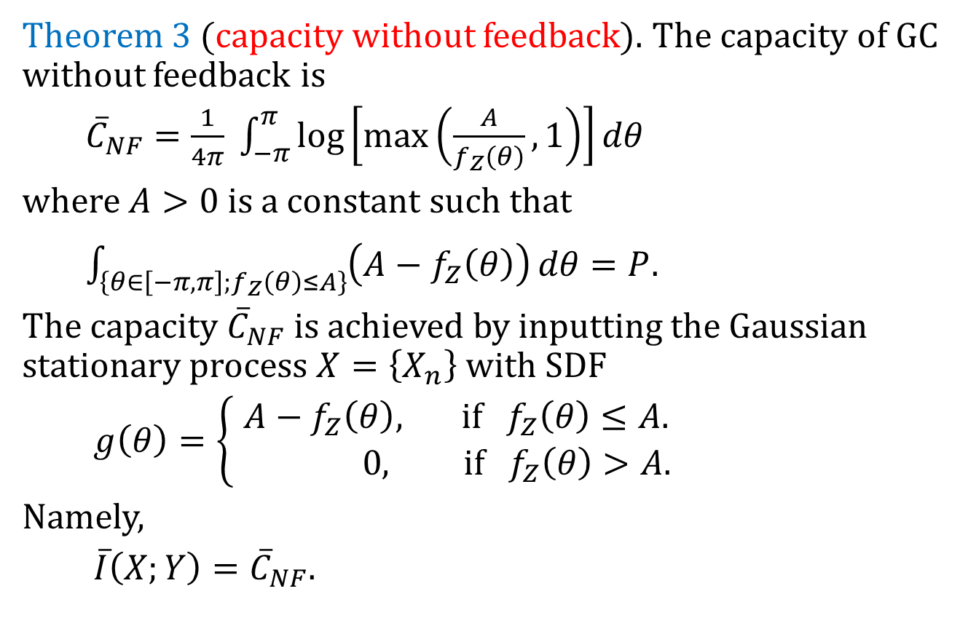
Theorem 3 (well known)
Theorem 3 (capacity without feedback). The capacity of GC without feedback is
${\overline{C}}_{NF}=\frac{1}{4π} \int_{−π}^{π}{\log\left[max\left(\frac{A}{f_{Z}\left(θ\right)},1\right)\right]}dθ$
where $A>0$is a constant such that
$\int_{\left\{θ∈\left[−π,π\right];f_{Z}\left(θ\right)≤A\right\}}{\left(A−f_{Z}\left(θ\right)\right)}dθ=P.$
The capacity ${\overline{C}}_{NF}$is achieved by inputting the Gaussian stationary process $X=\left\{X_{n}\right\}$with SDF
$g\left(θ\right)=\left\{\begin{aligned}A−f_{Z}\left(θ\right), if { f}_{Z}\left(θ\right)≤A. \\ 0, if f_{Z}\left(θ\right)>A. \end{aligned}\right.$
Namely,
$\overline{I}\left(X;Y\right)={\overline{C}}_{NF}.$

Slide 17

Theorem 4 (well known)
Theorem 4 (capacity of WGC). The capacity of the WGC is not increased by feedback and
${\overline{C}}_{FB}={\overline{C}}_{NF}=\frac{1}{2}\log\left(1+\frac{P}{σ^{2}}\right),$
where $σ^{2}$ is the variance of $Z_{n}$.

Slide 18
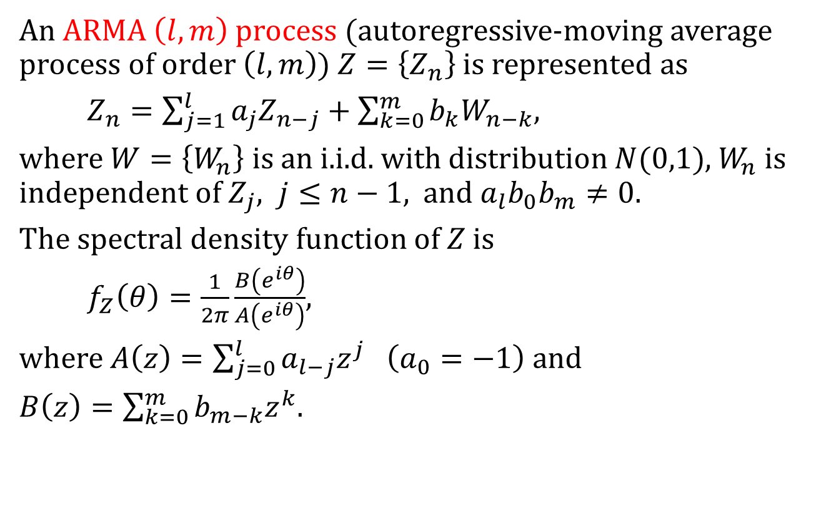
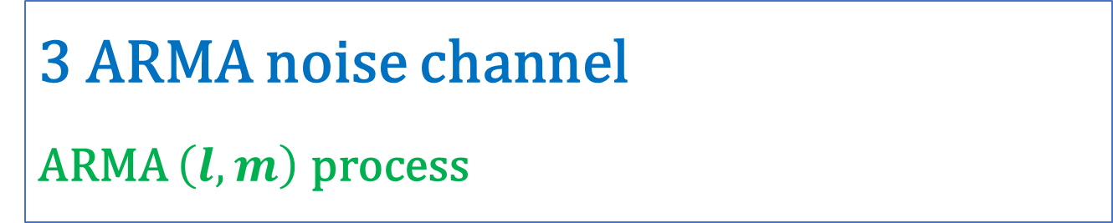
3 ARMA noise channel
ARMA $\left(l,m\right)$ process
An ARMA $\left(l,m\right)$ process (autoregressive-moving average process of order $\left(l,m\right)$) $Z=\left\{Z_{n}\right\}$ is represented as
$Z_{n}=\sum_{j=1}^{l}{a_{j}Z_{n−j}}+\sum_{k=0}^{m}{b_{k}W_{n−k},}$
where $W=\left\{W_{n}\right\}$is an i.i.d. with distribution $N(0,1)$, $W_{n}$ is independent of $Z_{j}, j≤n−1$, and $a_{l}b_{0}b_{m}≠0.$
The spectral density function of $Z$ is
$f_{Z}\left(θ\right)=\frac{1}{2π}\frac{B\left(e^{iθ}\right)}{A\left(e^{iθ}\right)}$,
where $A\left(z\right)=\sum_{j=0}^{l}{a_{l−j}z^{j} \left(a_{0}=−1\right)}$ and
$B\left(z\right)=\sum_{k=0}^{m}{b_{m−k}z^{k}. }$

Slide 19
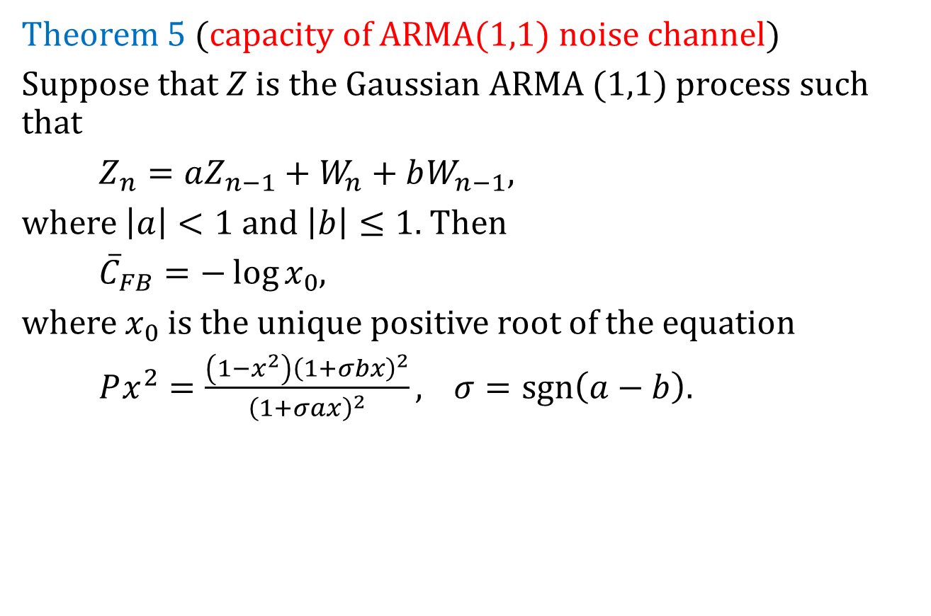
Theorem 5 (Kim, 2010)
Theorem 5 (capacity of ARMA(1,1) noise channel)
Suppose that $Z$ is the Gaussian ARMA (1,1) process such that
$Z_{n}=aZ_{n−1}+W_{n}+bW_{n−1},$
where $\left|a\right|<1$ and $\left|b\right|≤1$. Then
${\overline{C}}_{FB}=−\log{x_{0}}$,
where $x_{0}$ is the unique positive root of the equation
$Px^{2}=\frac{\left(1−x^{2}\right){\left(1+σbx\right)}^{2}}{{\left(1+σax\right)}^{2}},$ $σ=sgn\left(a−b\right).$

Slide 20
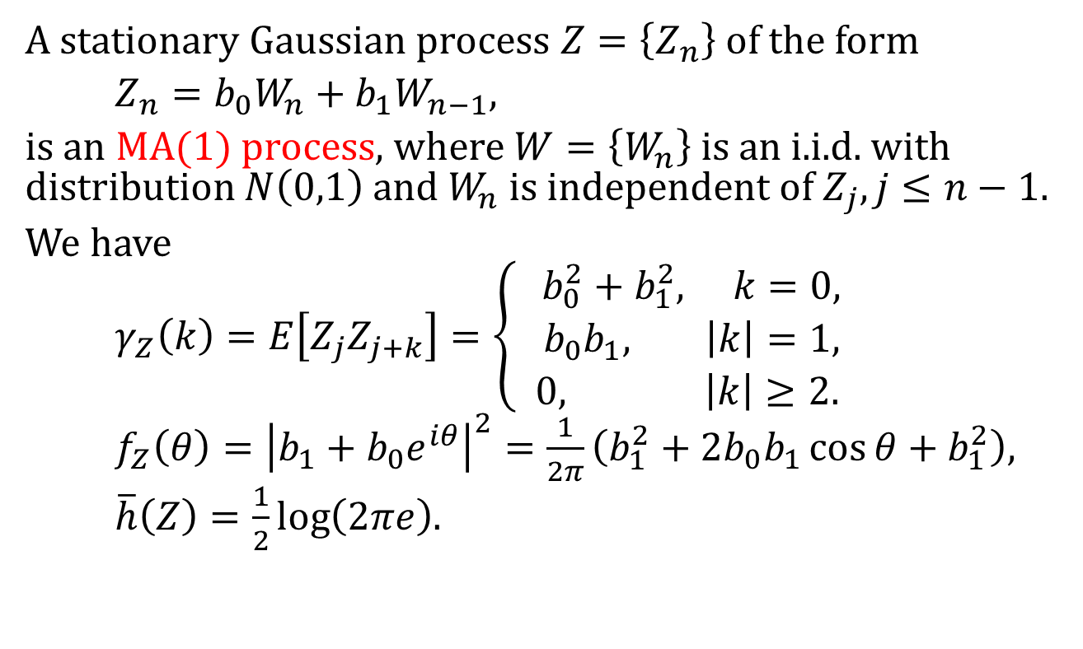
4 MA(1) noise channel
MA(1) process
A stationary Gaussian process $Z=\left\{Z_{n}\right\}$of the form
$Z_{n}=b_{0}W_{n}+b_{1}W_{n−1},$
is an MA(1) process, where $W=\left\{W_{n}\right\}$is an i.i.d. with distribution $N\left(0,1\right)$ and $W_{n}$is independent of $Z_{j},j≤n−1.$
We have
$γ_{Z}\left(k\right)=E\left[Z_{j}Z_{j+k}\right]=\left\{ \begin{aligned}b_{0}^{2}+b_{1}^{2}, k=0, \\ b_{0}b_{1}, \left|k\right|=1, \\ 0, \left|k\right|≥2. \end{aligned} \right.$
$f_{Z}\left(θ\right)={\left|b_{1}+b_{0}e^{iθ}\right|}^{2}=\frac{1}{2π}\left(b_{1}^{2}+2b_{0}b_{1}\cos{θ}+b_{1}^{2}\right),$
$\overline{h}\left(Z\right)=\frac{1}{2}\log\left(2πe\right).$

Slide 21
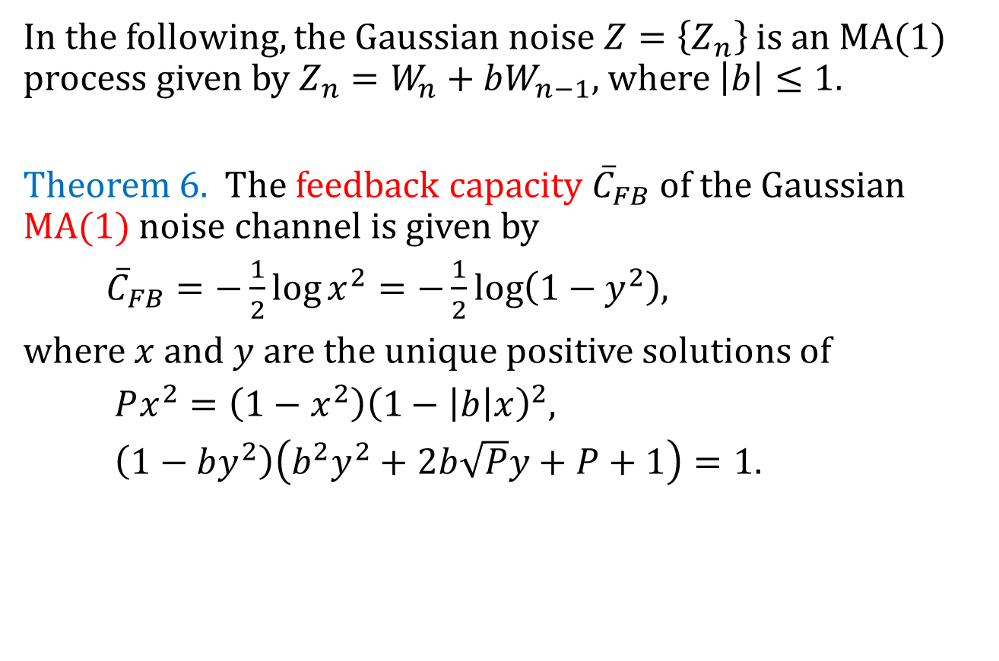
Theorem 6 (Kim, 2006, 2010)
In the following, the Gaussian noise $Z=\left\{Z_{n}\right\}$is an MA(1) process given by $Z_{n}=W_{n}+bW_{n−1}$, where $\left|b\right|≤1.$
Theorem 6. The feedback capacity ${\overline{C}}_{FB}$ of the Gaussian MA(1) noise channel is given by
${\overline{C}}_{FB}=−\frac{1}{2}\log{x^{2}}=−\frac{1}{2}\log\left(1−y^{2}\right)$,
where $x$ and $y$ are the unique positive solutions of
$Px^{2}=\left(1−x^{2}\right){\left(1−\left|b\right|x\right)}^{2},$
$\left(1−by^{2}\right)\left(b^{2}y^{2}+2b\sqrt{P}y+P+1\right)=1.$

Slide 22
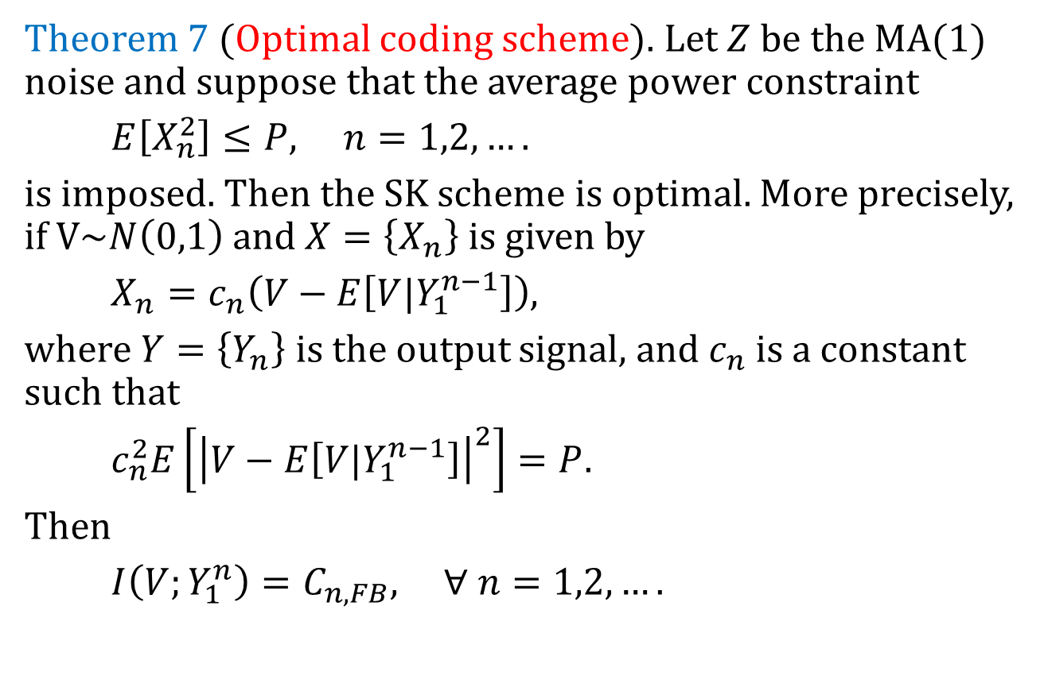
Theorem 7
Theorem 7 (Optimal coding scheme). Let $Z$ be the MA(1) noise and suppose that the average power constraint
$E\left[X_{n}^{2}\right]≤P, n=1,2,….$
is imposed. Then the SK scheme is optimal. More precisely, if $V\sim N\left(0,1\right)$ and $X=\left\{X_{n}\right\}$is given by
$X_{n}=c_{n}\left(V−E\left[V|Y_{1}^{n−1}\right]\right)$,
where $Y=\left\{Y_{n}\right\}$is the output signal, and $c_{n}$ is a constant such that
$c_{n}^{2}E\left[{\left|V−E\left[V|Y_{1}^{n−1}\right]\right|}^{2}\right]=P.$
Then
$I\left(V;Y_{1}^{n}\right)=C_{n,FB}, ∀ n=1,2,….$

Slide 23
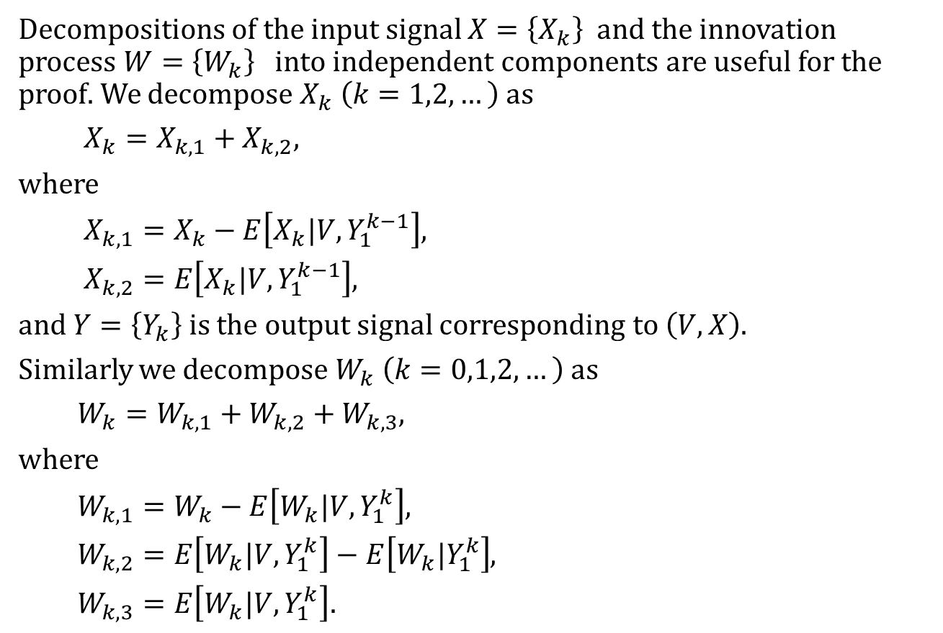
Proof of theorem 7 (Part 1)
Decompositions of the input signal $X=\left\{X_{k}\right\}$ and the innovation process $W=\left\{W_{k}\right\}$ into independent components are useful for the proof. We decompose $X_{k} \left(k=1,2,…\right)$ as
$X_{k}=X_{k,1}+X_{k,2},$
where
$X_{k,1}=X_{k}−E\left[X_{k}|V,Y_{1}^{k−1}\right]$,
$X_{k,2}=E\left[X_{k}|V,Y_{1}^{k−1}\right]$,
and $Y=\left\{Y_{k}\right\}$is the output signal corresponding to $\left(V,X\right).$
Similarly we decompose $W_{k} \left(k=0,1,2,…\right)$ as
$W_{k}=W_{k,1}+W_{k,2}+W_{k,3}$,
where
$W_{k,1}=W_{k}−E\left[W_{k}|V,Y_{1}^{k}\right]$,
$W_{k,2}=E\left[W_{k}|V,Y_{1}^{k}\right]−E\left[W_{k}|Y_{1}^{k}\right]$,
$W_{k,3}=E\left[W_{k}|V,Y_{1}^{k}\right].$

Slide 24
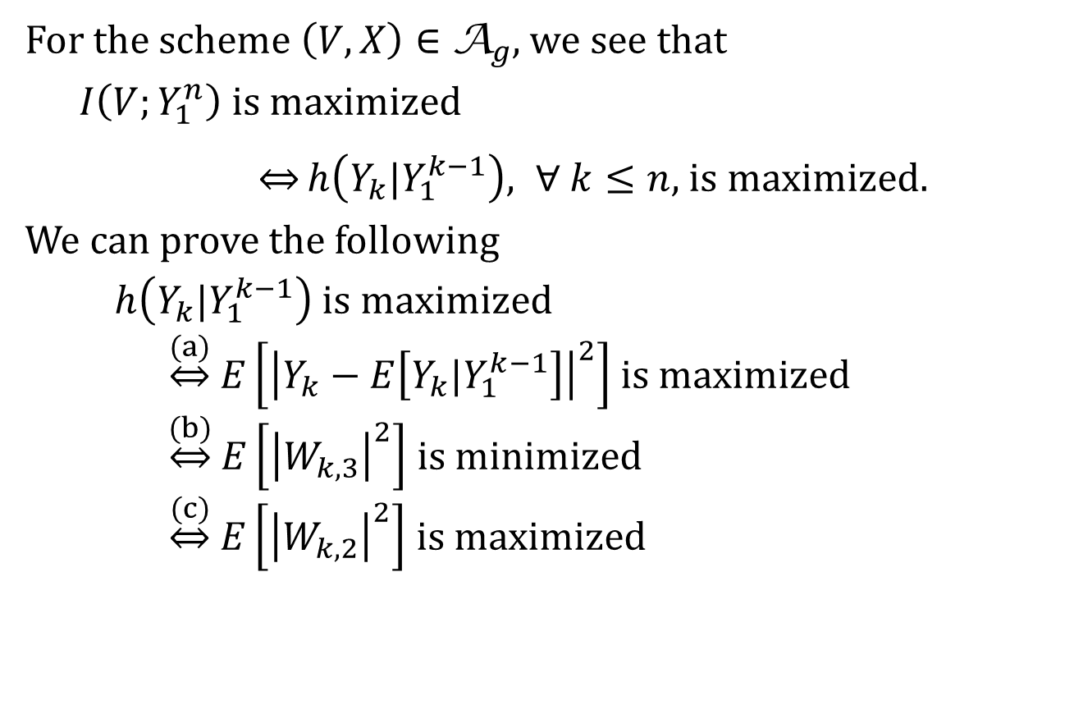
Proof of theorem 7 (Part 2)
For the scheme $\left(V,X\right)∈$ ${\text{A}}_{g}$, we see that
$I\left(V;Y_{1}^{n}\right)$ is maximized
$\underset{⇔}{}h\left(Y_{k}|Y_{1}^{k−1}\right), ∀ k≤n,$ is maximized.
We can prove the following
$h\left(Y_{k}|Y_{1}^{k−1}\right)$ is maximized
$\underset{⇔}{(a)}$ $E\left[{\left|Y_{k}−E\left[Y_{k}|Y_{1}^{k−1}\right]\right|}^{2}\right]$ is maximized
$\underset{⇔}{(b)}$ $E\left[{\left|W_{k,3}\right|}^{2}\right]$ is minimized
$\underset{⇔}{(c)}$ $E\left[{\left|W_{k,2}\right|}^{2}\right]$ is maximized

Slide 25
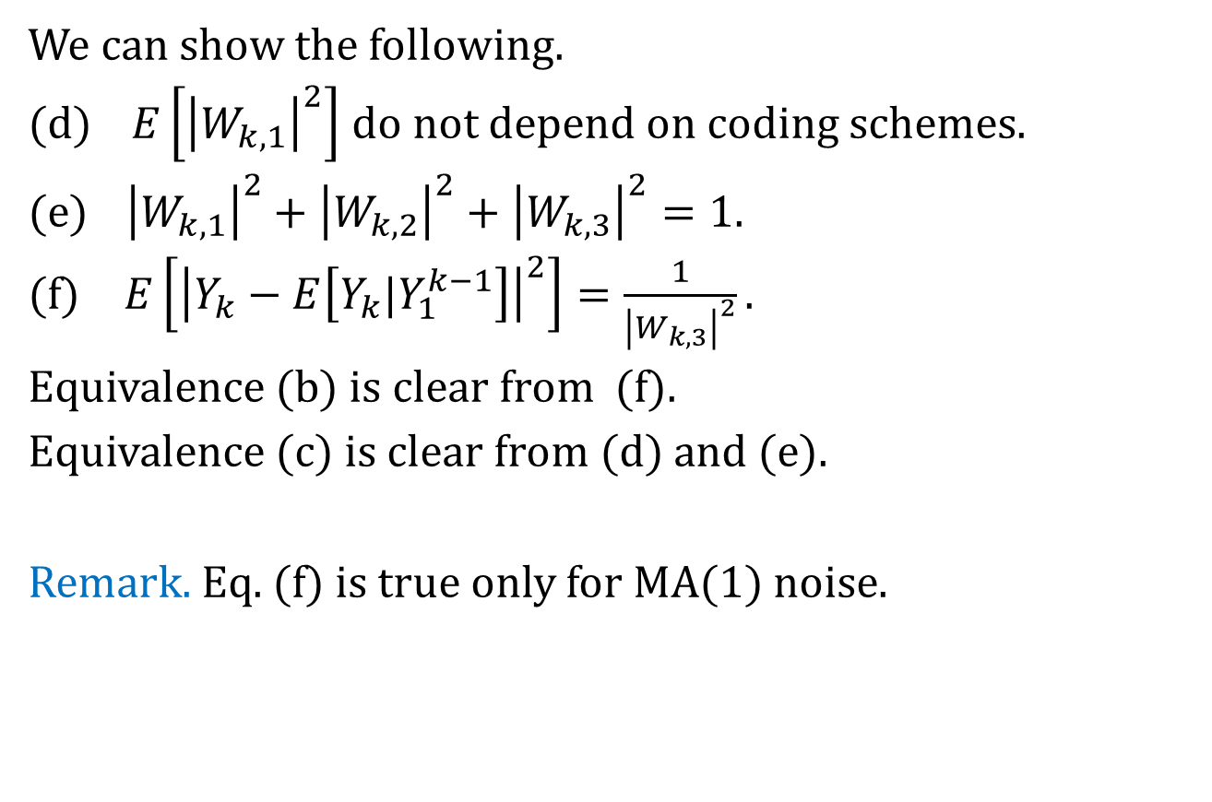
Proof of theorem 7 (Part 3)
We can show the following.
(d) $E\left[{\left|W_{k,1}\right|}^{2}\right]$ do not depend on coding schemes.
(e) ${\left|W_{k,1}\right|}^{2}+{\left|W_{k,2}\right|}^{2}+{\left|W_{k,3}\right|}^{2}=1.$
(f) $E\left[{\left|Y_{k}−E\left[Y_{k}|Y_{1}^{k−1}\right]\right|}^{2}\right]=\frac{1}{{\left|W_{k,3}\right|}^{2}}.$
Equivalence (b) is clear from (f).
Equivalence (c) is clear from (d) and (e).
Remark. Eq. (f) is true only for MA(1) noise.

Slide 26
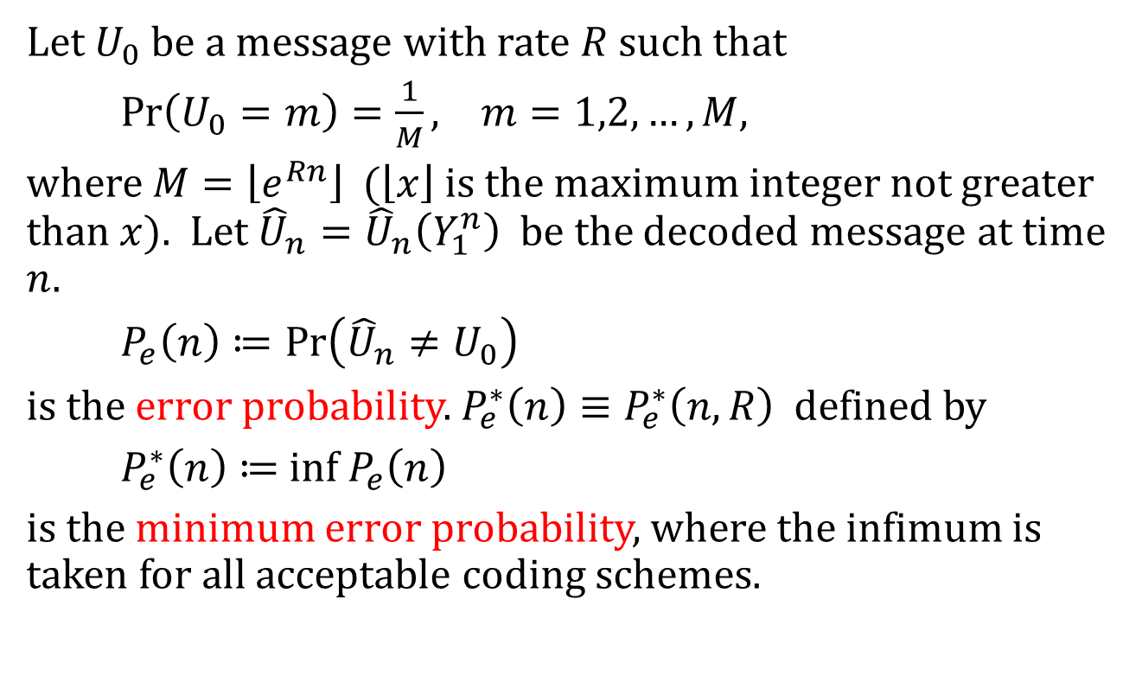
5 Asymptotic behavior of error probability
Error probability
Let $U_{0}$be a message with rate $R$such that
$Pr\left(U_{0}=m\right)=\frac{1}{M}, m=1,2,…,M,$
where $M=\left\lfloor e^{Rn}\right\rfloor$ ($\left\lfloor x\right\rfloor$is the maximum integer not greater than $x$). Let ${\hat{U}}_{n}={\hat{U}}_{n}\left(Y_{1}^{n}\right)$ be the decoded message at time $n$.
$P_{e}\left(n\right)≔Pr\left({\hat{U}}_{n}≠U_{0}\right)$
is the error probability. $P_{e}^{∗}\left(n\right)≡P_{e}^{∗}\left(n,R\right)$ defined by
$P_{e}^{∗}\left(n\right)≔$ inf${ P}_{e}\left(n\right)$
is the minimum error probability, where the infimum is taken for all acceptable coding schemes.

Slide 27

Notation
We denote by
$\exp_{n}\left(x\right)≔exp\left\{\exp_{n−1}\left(x\right)\right\}, n=1,2,…,$
the exponential function of order $n,$ where $\exp_{0}\left(x\right)=x$.
Example. $\exp_{1}\left(x\right)=e^{x},$ $\exp_{2}\left(x\right)=e^{e^{x}},$
$\exp_{3}\left(x\right)=e^{e^{e^{x}}},$….

Slide 28
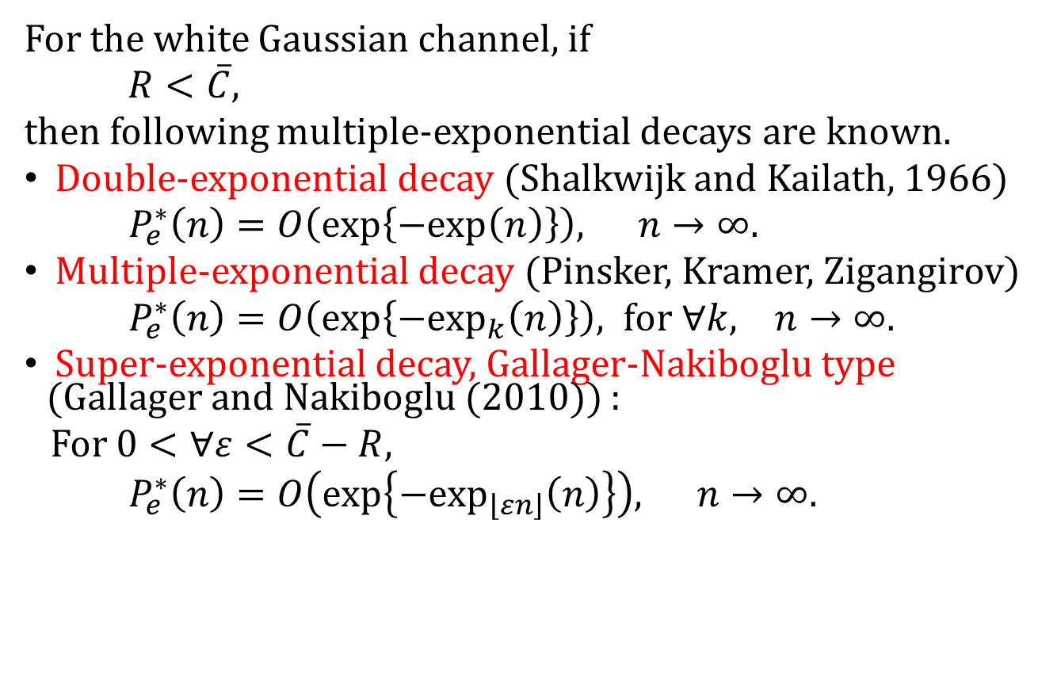
Multiple-exponential decay
For the white Gaussian channel, if
$R<\overline{C},$
then following multiple-exponential decays are known.
Double-exponential decay (Shalkwijk and Kailath, 1966)
$P_{e}^{∗}\left(n\right)=O\left(exp\left\{−exp\left(n\right)\right\}\right), n→∞.$
Multiple-exponential decay (Pinsker, Kramer, Zigangirov)
$P_{e}^{∗}\left(n\right)=O\left(exp\left\{−\exp_{k}\left(n\right)\right\}\right), for ∀k, n→∞.$
Super-exponential decay, Gallager-Nakiboglu type (Gallager and Nakiboglu (2010)) :
For $0<∀ε<\overline{C}−R,$
$P_{e}^{∗}\left(n\right)=O\left(exp\left\{−\exp_{\left\lfloor εn\right\rfloor }\left(n\right)\right\}\right), n→∞.$

Slide 29
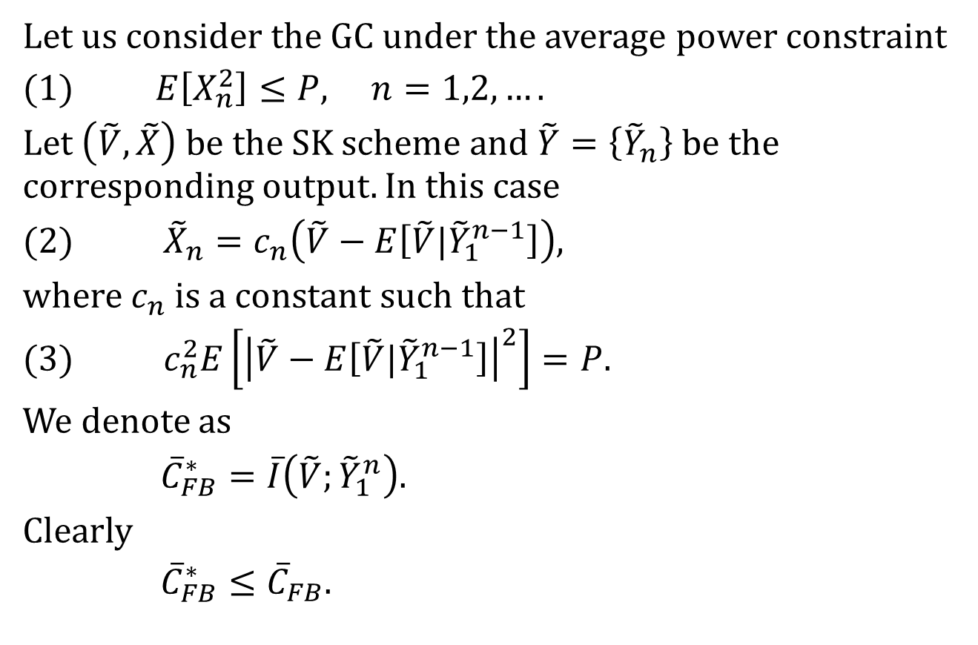
SK scheme and error probability
Let us consider the GC under the average power constraint
(1) $E\left[X_{n}^{2}\right]≤P, n=1,2,….$
Let $\left(\tilde{V},\tilde{X}\right)$be the SK scheme and $\tilde{Y}=\left\{{\tilde{Y}}_{n}\right\}$be the corresponding output. In this case
(2) ${\tilde{X}}_{n}=c_{n}\left(\tilde{V}−E\left[\tilde{V}|{\tilde{Y}}_{1}^{n−1}\right]\right)$,
where $c_{n}$is a constant such that
(3) $c_{n}^{2}E\left[{\left|\tilde{V}−E\left[\tilde{V}|{\tilde{Y}}_{1}^{n−1}\right]\right|}^{2}\right]=P.$
We denote as
${\overline{C}}_{FB}^{∗}=\overline{I}\left(\tilde{V};{\tilde{Y}}_{1}^{n}\right).$
Clearly
${\overline{C}}_{FB}^{∗}≤{\overline{C}}_{FB}.$

Slide 30
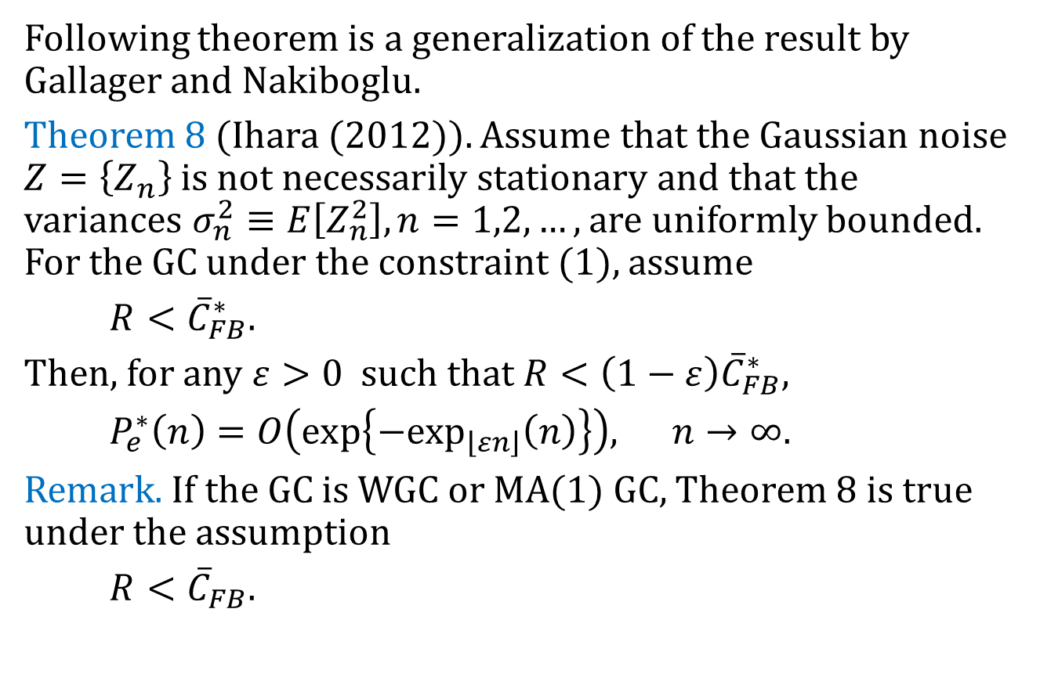
SK scheme and error probability
Following theorem is a generalization of the result by Gallager and Nakiboglu.
Theorem 8 (Ihara (2012)). Assume that the Gaussian noise $Z=\left\{Z_{n}\right\}$is not necessarily stationary and that the variances $σ_{n}^{2}≡E\left[Z_{n}^{2}\right], n=1,2,…,$ are uniformly bounded. For the GC under the constraint (1), assume
$R<{\overline{C}}_{FB}^{∗}.$
Then, for any $ε>0$such that $R<\left(1−ε\right){\overline{C}}_{FB}^{∗},$
$P_{e}^{∗}\left(n\right)=O\left(exp\left\{−\exp_{\left\lfloor εn\right\rfloor }\left(n\right)\right\}\right), n→∞.$
Remark. If the GC is WGC or MA(1) GC, Theorem 8 is true under the assumption
$R<{\overline{C}}_{FB}.$

Slide 31
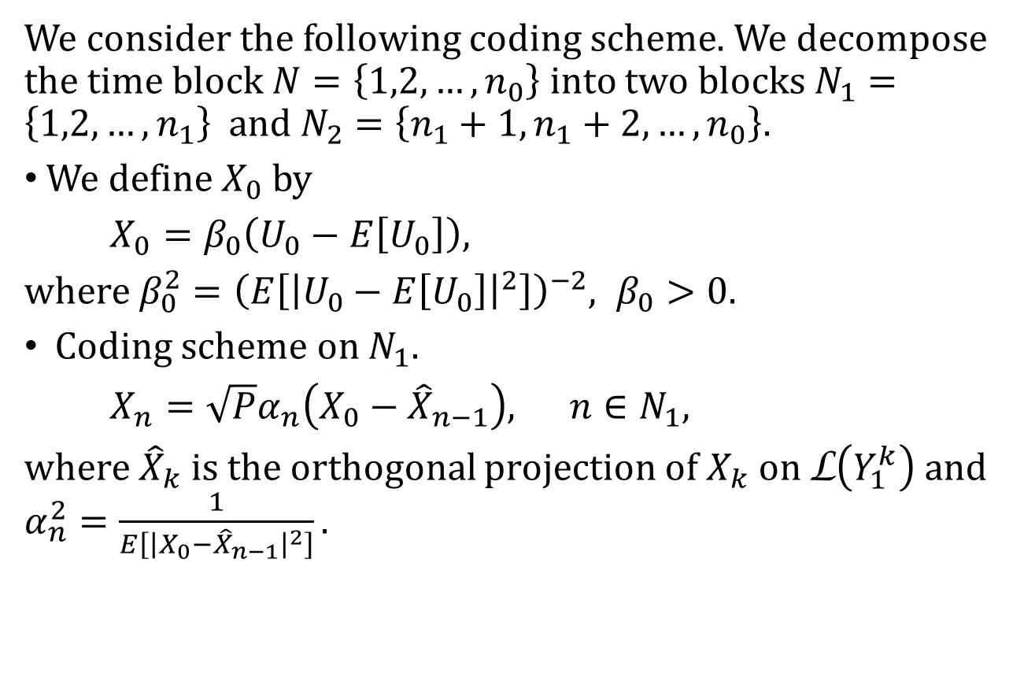
Proof of Theorem 8 (Part 1)
We consider the following coding scheme. We decompose the time block $N=\left\{1,2,…,n_{0}\right\}$ into two blocks $N_{1}=\left\{1,2,…,n_{1}\right\}$ and $N_{2}=\left\{n_{1}+1,n_{1}+2,…,n_{0}\right\}.$
We define $X_{0}$by
$X_{0}=β_{0}\left(U_{0}−E\left[U_{0}\right]\right),$
where $β_{0}^{2}={\left(E\left[{\left|U_{0}−E\left[U_{0}\right]\right|}^{2}\right]\right)}^{−2}, β_{0}>0.$
Coding scheme on $N_{1}.$
$X_{n}={\sqrt{P}α}_{n}\left(X_{0}−{\hat{X}}_{n−1}\right), n∈N_{1},$
where ${\hat{X}}_{k}$ is the orthogonal projection of $X_{k}$ on L$\left(Y_{1}^{k}\right)$and $α_{n}^{2}=\frac{1}{E\left[{\left|X_{0}−{\hat{X}}_{n−1}\right|}^{2}\right]}.$

Slide 32
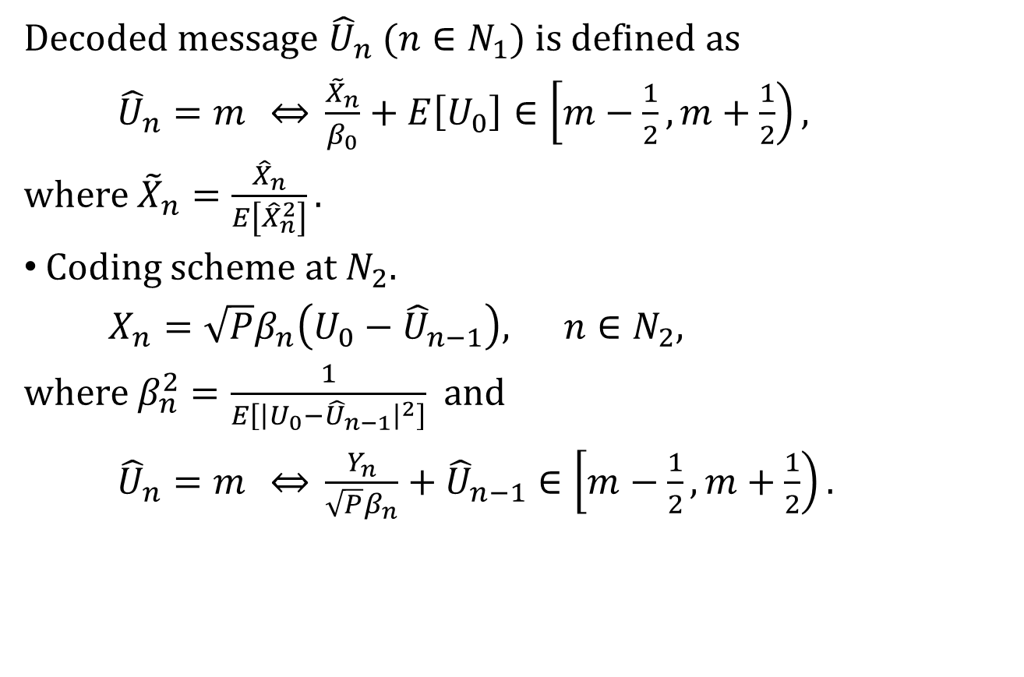
Proof of Theorem 8 (Part 2)
Decoded message ${\hat{U}}_{n}$ ($n∈N_{1}$) is defined as
${\hat{U}}_{n}=m \underset{⇔}{} \frac{{\tilde{X}}_{n}}{β_{0}}+E\left[U_{0}\right]∈\left[m−\frac{1}{2},m+\frac{1}{2}\right),$
where ${\tilde{X}}_{n}=\frac{{\hat{X}}_{n}}{E\left[{\hat{X}}_{n}^{2}\right]}.$
Coding scheme at $N_{2}.$
$X_{n}={\sqrt{P}β}_{n}\left(U_{0}−{\hat{U}}_{n−1}\right), n∈N_{2},$
where $β_{n}^{2}=\frac{1}{E\left[{\left|U_{0}−{\hat{U}}_{n−1}\right|}^{2}\right]}$ and
${\hat{U}}_{n}=m \underset{⇔}{} \frac{Y_{n}}{{\sqrt{P}β}_{n}}+{\hat{U}}_{n−1}∈\left[m−\frac{1}{2},m+\frac{1}{2}\right).$

Slide 33
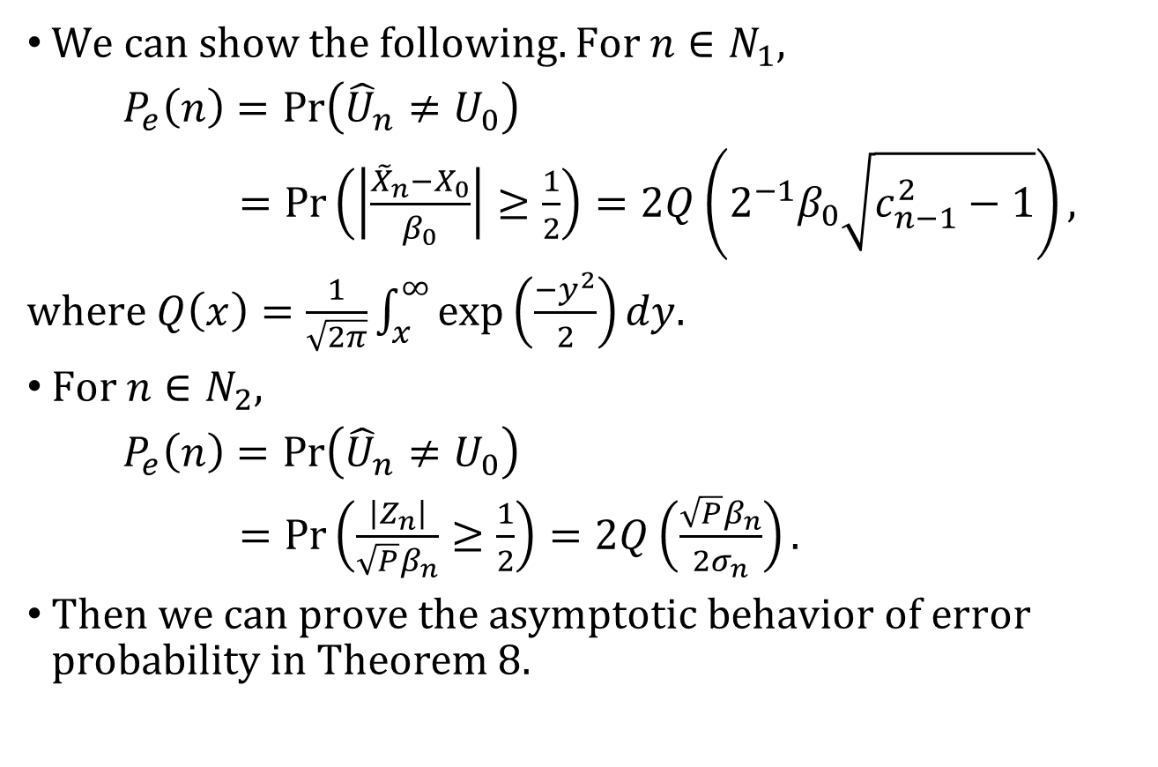
Proof of Theorem 8 (Part 3)
We can show the following. For $n∈N_{1},$
$P_{e}\left(n\right)=Pr\left({\hat{U}}_{n}≠U_{0}\right)$
$=Pr\left(\left|\frac{{\tilde{X}}_{n}−X_{0}}{β_{0}}\right|≥\frac{1}{2}\right)$ $=2Q\left(2^{−1}β_{0}\sqrt{c_{n−1}^{2}−1}\right),$
where $Q\left(x\right)=\frac{1}{\sqrt{2π}}\int_{x}^{∞}{exp\left(\frac{−y^{2}}{2}\right)}dy.$
For $n∈N_{2},$
$P_{e}\left(n\right)=Pr\left({\hat{U}}_{n}≠U_{0}\right)$
$=Pr\left(\frac{\left|Z_{n}\right|}{\sqrt{P}β_{n}}≥\frac{1}{2}\right)$ $=2Q\left(\frac{\sqrt{P}β_{n}}{2σ_{n}}\right).$
Then we can prove the asymptotic behavior of error probability in Theorem 8.

Slide 34
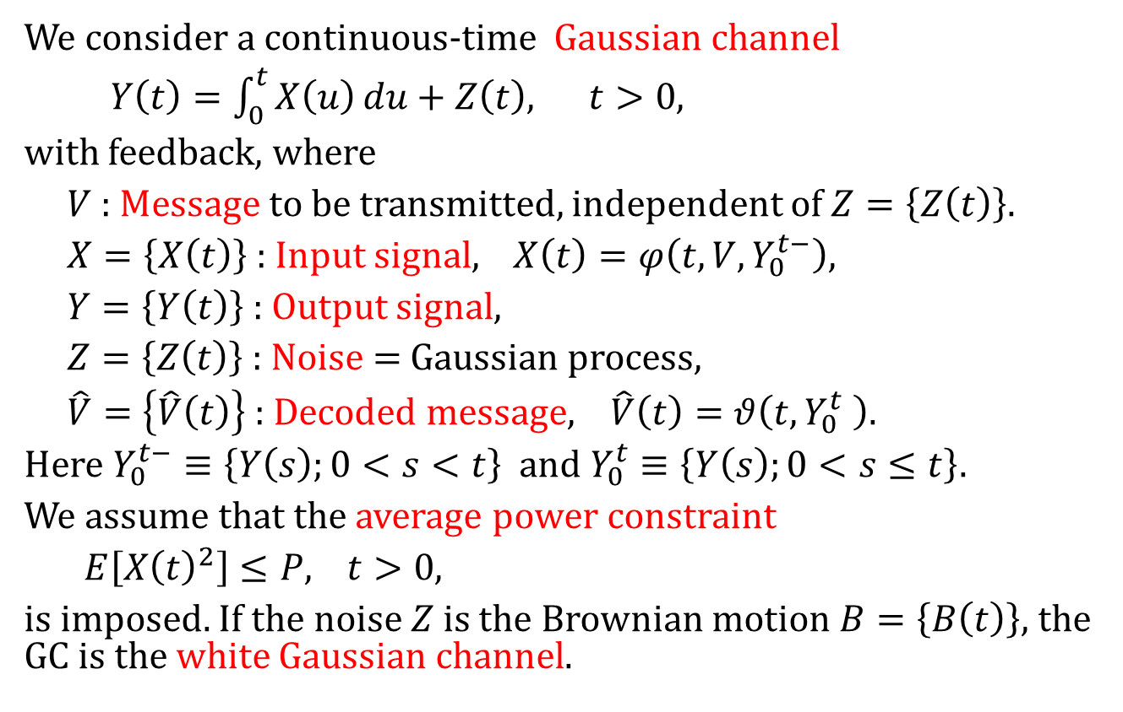
6 Continuous-time GC with feedback
We consider a continuous-time Gaussian channel
$Y\left(t\right)=\int_{0}^{t}{X\left(u\right)}du+Z\left(t\right), t>0,$
with feedback, where
$V$ : Message to be transmitted, independent of $Z=\left\{Z\left(t\right)\right\}.$
$X=\left\{X\left(t\right)\right\}$ : Input signal, $X\left(t\right)=φ\left(t,V,Y_{0}^{t−}\right)$,
$Y=\left\{Y\left(t\right)\right\}$ : Output signal,
$Z=\left\{Z\left(t\right)\right\}$ : Noise = Gaussian process,
$\hat{V}=\left\{\hat{V}\left(t\right)\right\}$ : Decoded message, $\hat{V}\left(t\right)=θ\left(t,Y_{0}^{t} \right)$.
Here $Y_{0}^{t−}≡\left\{Y\left(s\right);0<s<t\right\}$ and $Y_{0}^{t}≡\left\{Y\left(s\right);0<s≤t\right\}$.
We assume that the average power constraint
$E\left[{X\left(t\right)}^{2}\right]≤P$,$t>0,$
is imposed. If the noise $Z$ is the Brownian motion $B=\left\{B\left(t\right)\right\},$the GC is the white Gaussian channel.

Slide 35
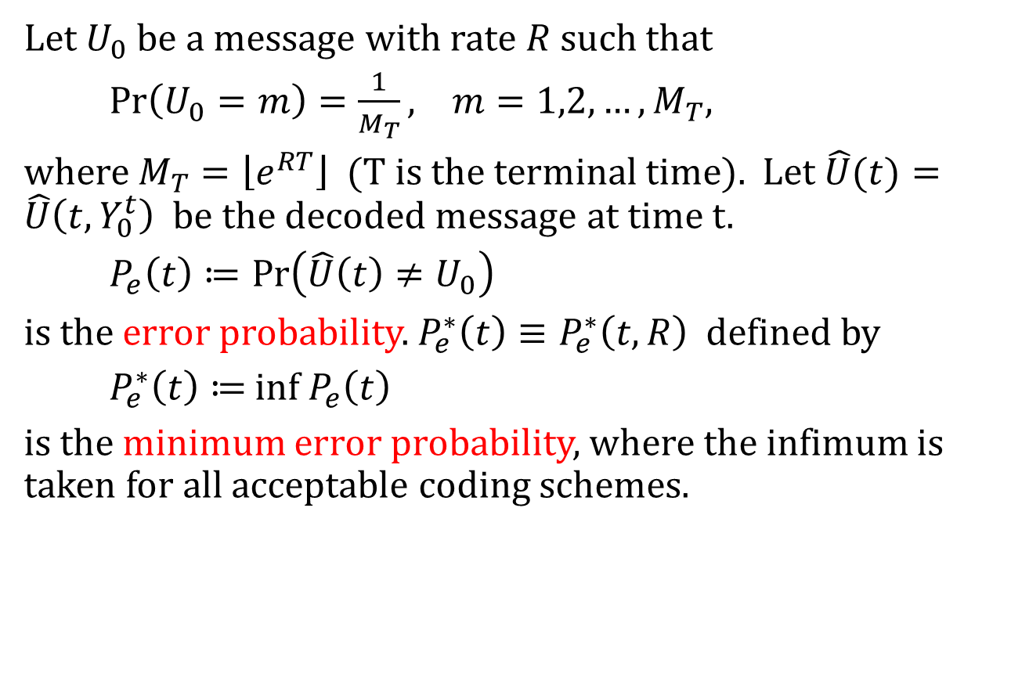
Error probability
Let $U_{0}$be a message with rate $R$such that
$Pr\left(U_{0}=m\right)=\frac{1}{M_{T}}, m=1,2,…,M_{T},$
where $M_{T}=\left\lfloor e^{RT}\right\rfloor$ ($T$is the terminal time). Let $\hat{U}(t)=\hat{U}\left(t,Y_{0}^{t}\right)$ be the decoded message at time t.
$P_{e}\left(t\right)≔Pr\left(\hat{U}\left(t\right)≠U_{0}\right)$
is the error probability. $P_{e}^{∗}\left(t\right)≡P_{e}^{∗}\left(t,R\right)$ defined by
$P_{e}^{∗}\left(t\right)≔$ inf${ P}_{e}\left(t\right)$
is the minimum error probability, where the infimum is taken for all acceptable coding schemes.

Slide 36
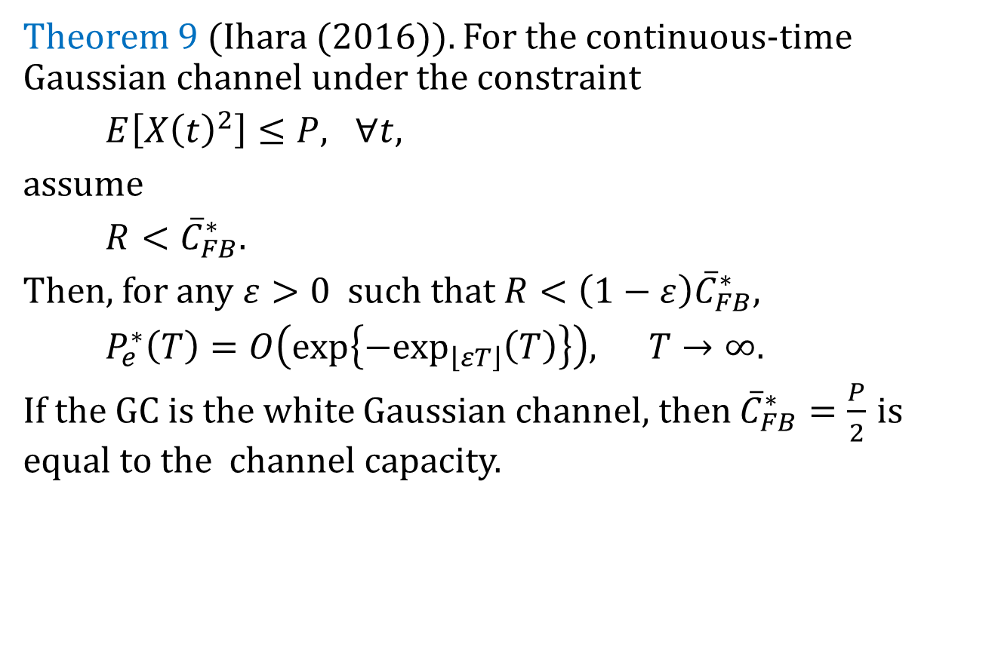
Minimum error probability
Theorem 9 (Ihara (2016)). For the continuous-time Gaussian channel under the constraint
$E\left[{X\left(t\right)}^{2}\right]≤P, ∀t,$
assume
$R<{\overline{C}}_{FB}^{∗}.$
Then, for any $ε>0$such that $R<\left(1−ε\right){\overline{C}}_{FB}^{∗},$
$P_{e}^{∗}\left(T\right)=O\left(exp\left\{−\exp_{\left\lfloor εT\right\rfloor }\left(T\right)\right\}\right), T→∞.$
If the GC is the white Gaussian channel, then ${\overline{C}}_{FB}^{∗}=\frac{P}{2}$ is equal to the channel capacity.

Slide 37
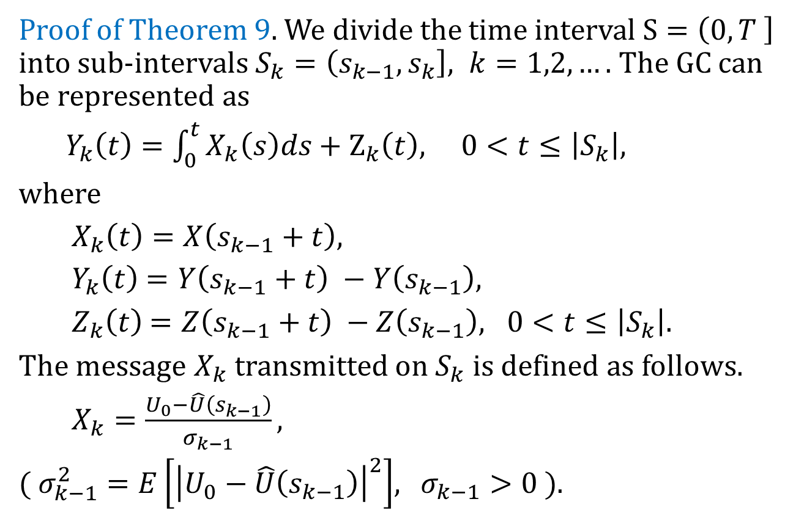
Proof of Theorem 9 (Part 1)
Proof of Theorem 9. We divide the time interval $S=\left(0,T \right]$ into sub-intervals $S_{k}=\left(s_{k−1},s_{k}\right], k=1,2,….$The GC can be represented as
$Y_{k}\left(t\right)=\int_{0}^{t}{X_{k}\left(s\right)ds+Z_{k}\left(t\right), 0<t≤\left|S_{k}\right|, }$
where
$X_{k}\left(t\right)=X\left(s_{k−1}+t\right),$
$Y_{k}\left(t\right)$= $Y\left(s_{k−1}+t\right) −Y\left(s_{k−1}\right),$
$Z_{k}\left(t\right)$= $Z\left(s_{k−1}+t\right) −Z\left(s_{k−1}\right), 0<t≤\left|S_{k}\right|.$
The message $X_{k}$ transmitted on $S_{k}$is defined as follows.
$X_{k}=\frac{U_{0}−\hat{U}\left(s_{k−1}\right)}{σ_{k−1}},$
( $σ_{k−1}^{2}=E\left[{\left|U_{0}−\hat{U}\left(s_{k−1}\right)\right|}^{2}\right]$, $σ_{k−1}>0 )$.

Slide 38
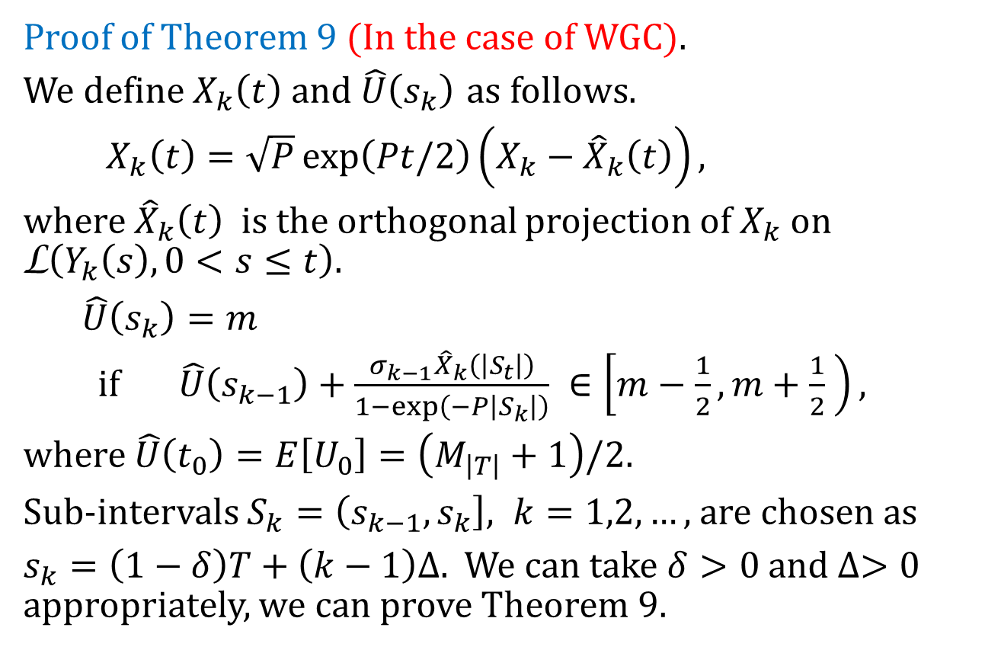
Proof of Theorem 9 (Part 2)
Proof of Theorem 9 (In the case of WGC).
We define $X_{k}\left(t\right)$ and $\hat{U}\left(s_{k}\right)$ as follows.
$X_{k}\left(t\right)=\sqrt{P}\exp\left(Pt/2\right)\left(X_{k}−{\hat{X}}_{k}\left(t\right)\right),$
where ${\hat{X}}_{k}\left(t\right)$ is the orthogonal projection of $X_{k}$on L$\left(Y_{k}\left(s\right), 0<s≤t\right).$
$\hat{U}\left(s_{k}\right)=m$
if $\hat{U}\left(s_{k−1}\right)+\frac{σ_{k−1}{\hat{X}}_{k}\left(\left|S_{t}\right|\right)}{1−\exp\left(−P\left|S_{k}\right|\right)} ∈\left[m−\frac{1}{2}, m+\frac{1}{2} \right),$
where $\hat{U}\left(t_{0}\right)=E\left[U_{0}\right]=\left(M_{\left|T\right|}+1\right)/2.$
Sub-intervals $S_{k}=\left(s_{k−1}, s_{k}\right], k=1,2,…,$are chosen as
$s_{k}=\left(1−δ\right)T+\left(k−1\right)∆.$ We can take $δ>0$and $∆>0$ appropriately, we can prove Theorem 9.

Slide 39
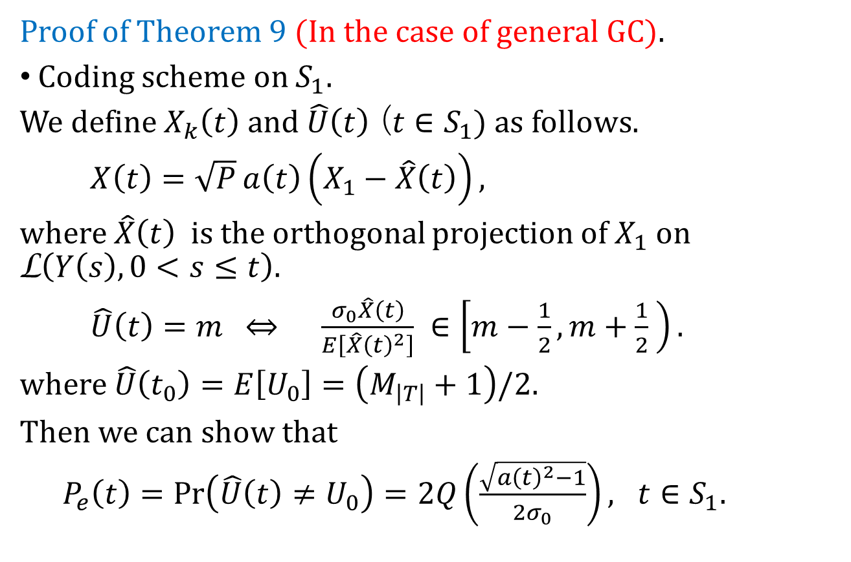
Proof of Theorem 9 (Part 3)
Proof of Theorem 9 (In the case of general GC).
Coding scheme on $S_{1}.$
We define $X_{k}\left(t\right)$ and $\hat{U}\left(t\right)$ ($t∈S_{1}$) as follows.
$X\left(t\right)=\sqrt{P}a\left(t\right)\left(X_{1}−\hat{X}\left(t\right)\right),$
where $\hat{X}\left(t\right)$ is the orthogonal projection of $X_{1}$on L$\left(Y\left(s\right), 0<s≤t\right).$
$\hat{U}\left(t\right)=m$ $\frac{σ_{0}\hat{X}\left(t\right)}{E\left[{\hat{X}\left(t\right)}^{2}\right]} ∈\left[m−\frac{1}{2}, m+\frac{1}{2} \right).$
where $\hat{U}\left(t_{0}\right)=E\left[U_{0}\right]=\left(M_{\left|T\right|}+1\right)/2.$
Then we can show that
$P_{e}\left(t\right)=Pr\left(\hat{U}\left(t\right)≠U_{0}\right)=2Q\left(\frac{\sqrt{{a\left(t\right)}^{2}−1}}{2σ_{0}}\right), t∈S_{1}.$

Slide 40
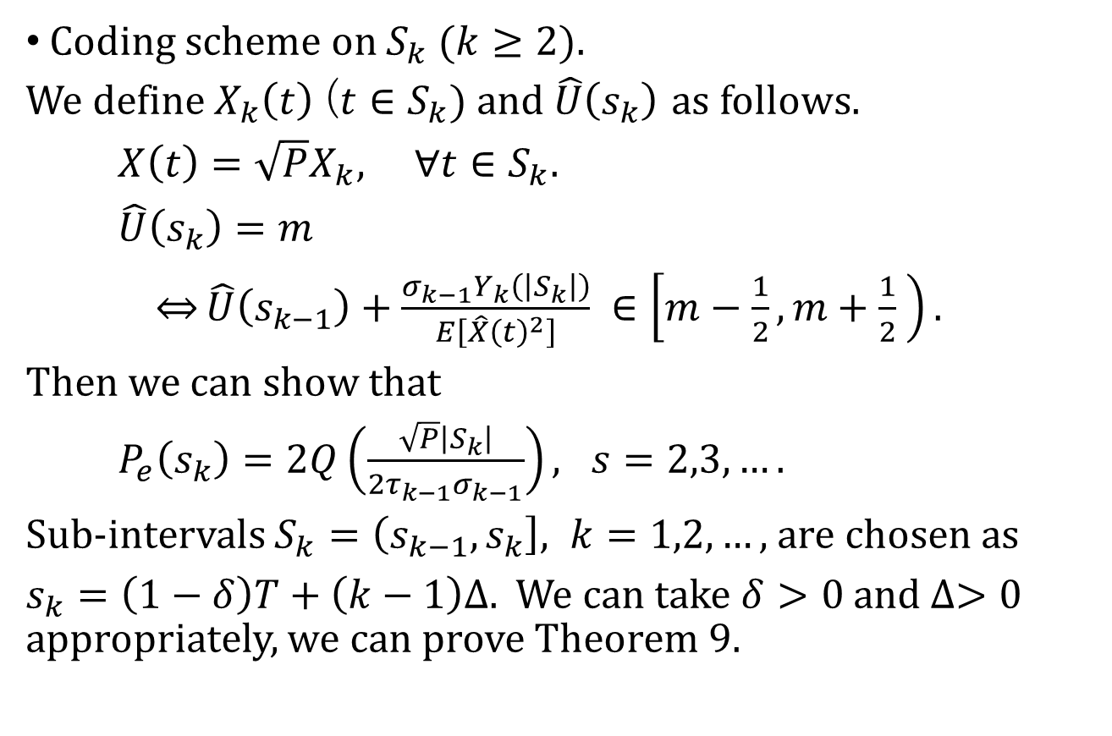
Proof of Theorem 9 (Part 4)
Coding scheme on $S_{k} (k≥2).$
We define $X_{k}\left(t\right)$ ($t∈S_{k}$) and $\hat{U}\left(s_{k}\right)$ as follows.
$X\left(t\right)=\sqrt{P}X_{k}, ∀t∈S_{k}.$
$\hat{U}\left(s_{k}\right)=m$
$\underset{⇔}{}\hat{U}\left(s_{k−1}\right)+\frac{σ_{k−1}Y_{k}\left(\left|S_{k}\right|\right)}{E\left[{\hat{X}\left(t\right)}^{2}\right]} ∈\left[m−\frac{1}{2}, m+\frac{1}{2} \right).$
Then we can show that
$P_{e}\left(s_{k}\right)=2Q\left(\frac{\sqrt{P}\left|S_{k}\right|}{2τ_{k−1}σ_{k−1}}\right), s=2,3,….$
Sub-intervals $S_{k}=\left(s_{k−1}, s_{k}\right], k=1,2,…,$are chosen as
$s_{k}=\left(1−δ\right)T+\left(k−1\right)∆.$ We can take $δ>0$and $∆>0$ appropriately, we can prove Theorem 9.

Slide 41
References
[1] T. M. Cover and J. A. Thomas: Elements of Information
Theory, 2nd Ed., Wiley, New York, 2006.
[2] R. G. Gallager and B. Nakiboglu: Variations on a theme by
Schalkwijk and Kailath. IEEE Trans. Inform. Theory, vol. IT-56,
no. 1, pp. 6--18, Jan. 2010.
[3] S. Ihara: Information Theory for Continuous Systems.
World Scientific, Singapore, 1993.
[4] S. Ihara: Upper bounds of error probabilities for stationary
Gaussian channels with feedback. IEEE Trans. Inform.
Theory, vol. IT-58, no. 12, pp. 7068--7072, Dec. 2012.
[5] S. Ihara: Upper bounds of error probabilities for stationary
Gaussian channels with feedback. IEEE Trans. Inform. Theory
vol. 58, no 12, pp. 7068--7072, Dec. 2012.

Slide 42
[6] S. Ihara: Asymptotic behavior of error probability in
continuous-time Gaussian channels with feedback. IEICE
Trans. Fundamentals, vol. E99, no 12, pp. 2106--2115,
Dec. 2016.
[7] S. Ihara: On the feedback capacity of the first-order moving
average Gaussian channel. Japanese J. Statistics Data Sci. , 2019.
[8] Y.-H. Kim: Feedback capacity of the first-order moving
average Gaussian channel. IEEE Trans. Inform. Theory, vol.
IT-52, no 7, pp. 3063--3079, July 2006.
[9] Y.-H. Kim: Feedback capacity of stationary Gaussian
channels. IEEE Trans. Inform. Theory, vol. IT-56, no 1, pp.
57--85, Jan. 2010.

Slide 43
[10] A. J. Kramer: Improving communication reliability by
use of an intermittent feedback channel. IEEE Trans.
Inform. Theory, IT-15, no. 1, pp. 52--60, 1969.
[11] M. S. Pinsker: Information and Information Stability of
Random Variables and Processes. Holden-Day, San
Francisco, 1964.
[12] M. S. Pinsker: The probability of error in block
transmission in a memoryless Gaussian channel with
feedback. Problems Inform. Transmission, vol. 4, pp. 1—14,
1968.
[13] J.P.M. Shalkwijk and T. Kailath: A coding scheme for additive
noise channels with feedback - I: No bandwidth constraint
IEEE Trans. Inform. Theory, vol. IT-12, no 2, pp. 172—182,
Apr. 1966.

Slide 44
[14] J.P.M. Shalkwijk: A coding scheme for additive noise
channels with feedback - II: Band-limited signals. IEEE
Trans. Inform. Theory, vol. IT-12, no 2, pp. 183--189, Apr.
1966.
[15] K. Sh. Zigangirov: Upper bound for the error
probability for Gaussian channels with feedback.
Problems Inform. Transmission, vol. 6, pp. 159--163,
1970.

Slide 45

ABC
L
ABC
L
ABCL ${\begin{aligned}\text{A} \\ \text{A}\end{aligned}}_{g} {\text{A}}_{s}$

