Slide 1
1
RELIABLE COMMUNICATION
IN THE PRESENCE OF
LIMITED
ADVERSARIES
Sidharth Jaggi, The Chinese University of Hong Kong

Slide 2
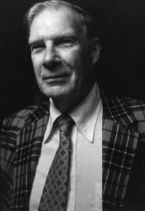
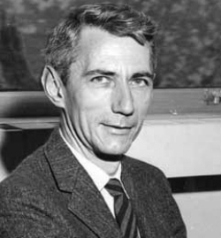
Between Shannon and Hamming:
Codes against limited adversaries

Slide 3
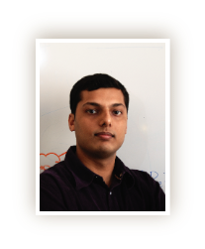
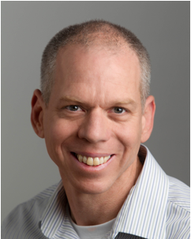
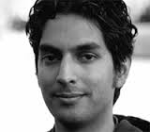
3
Research group:
Codes, Algorithms, Networks:
Design & Optimization for
Information Theory
Codes, Algorithms, Networks:
Design & Optimization for
Information Theory
ME
Zitan Chen
Qiaosheng Zhang
Mayank Bakshi
Sidharth Jaggi
Swanand Kadhe
Alex Sprintson
Michael Langberg
Bikash Kumar Dey
Anand Dilip Sarwate

Slide 4
Background – Communication Scenario
4
Bad guy
Calvin
Alice
011100110110111101110011
Bob
$$u^{k}$$
Encoder
$$x^{n}$$
$$y^{n}$$
Decoder
$${\hat{u}}^{k}$$
(Adversarial)
Noisy Channel
Message
Codeword
Received
word
Decoded
message
Notes:
the n superscript not visible.

Slide 5
Background – Related Work
5
“Benchmark” channel models
One extreme: random noise (Shannon)
$$u^{k}$$
$$x^{n}$$
$$y^{n}$$
$${\hat{u}}^{k}$$
= u^{k} w.h.p.
$$e^{n}$$
Alphabet $q$
$$R=\frac{k}{n}$$
$pn$ errors
(q-ary symmetric channel)
1
q=2 (binary)
1
general q
1
“large” q
{Sha48]
[Sha48]
[Sha48]
R
R
R
p
0.5
p
1-1/q
1
p
Many “good” codes (computationally efficient, “close to” capacity)
Notes:
Be nice to have an actual adversary who looks blind.

Slide 6
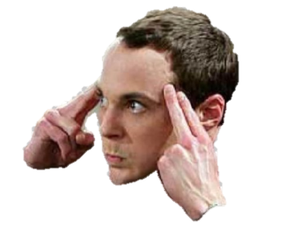
Background – Related Work
6
“Benchmark” channel models
The other extreme: omniscient adversary (Hamming)
One extreme: random noise (Shannon)
$$u^{k}$$
$$x^{n}$$
$$y^{n}$$
$${\hat{u}}^{k}$$
Calvin
He knows “everything”!
1
q=2 (binary)
1
“large” q
1-2p
[Reed-Solomon]/[Singleton]
R
[McERRW77]
R
[Gilbert Varshamov]
0.25
0.5
0.5
1
p
p
“Good, computationally efficient” codes for large q, not so much for small q
Notes:
Intermediate q – AG codes achievability,/McERRW outer bound, still a gap. Show both curves.

Slide 7
x₂(0), p₂
x₁(0), p₁
x₃(0), p₃
x₅(0), p₅
x₄(0), p₄
Avg P_{e}:
Max P_{e}:
1
R
p
0.5

Slide 8
Avg P_{e}:
Avg P_{e}:
Max P_{e}:
Max P_{e}:
1
1
R
R
[McERRW77]
[Gilbert Varshamov]
p
0.5
p
0.5

Slide 9
Background – Related Work
9
“Benchmark” channel models
The other extreme: omniscient adversary
One extreme: random noise
$$u^{k}$$
$$x^{n}$$
$$y^{n}$$
$${\hat{u}}^{k}$$
Calvin
He knows “everything”!
1
q=2 (binary)
1
“intermediate” q
1
“large” q
[Sha48]
[Reed-Solomon]/[Singleton]
R
[McERRW77]
R
[Gilbert Varshamov]
p
0.5
p
0.5
1
p
Notes:
Intermediate q – AG codes achievability,/McERRW outer bound, still a gap. Show both curves.

Slide 10
Background – Related Work
10
“Benchmark” channel models
One intermediate model: oblivious adversary
$$u^{k}$$
$$x^{n}$$
$$y^{n}$$
$${\hat{u}}^{k}$$
$$e^{n}$$
Alphabet $q$
$$R=\frac{k}{n}$$
$pn$ errors
1
q=2 (binary)
1
“large” q
(AVC capacity)
(AVC capacity/folklore)
R
R
p
0.5
1
p
Notes:
Be nice to have an actual adversary who looks blind.

Slide 11
Background – Related Work
11
“Benchmark” channel models
One intermediate model: oblivious adversary
$$u^{k}$$
$$x^{n}$$
$$y^{n}$$
$${\hat{u}}^{k}$$
s
$$e^{n}$$
Alphabet $q$
$$R=\frac{k}{n}$$
$pn$ errors
e^{n}: Error function of codebook,
message u^{k}, but NOT codeword x^{n}
s: Secret key known
only to Alice (NOT Bob/Calvin)
1
q=2 (binary)
1
“large” q
(AVC capacity)
(AVC capacity/folklore)
R
R
p
0.5
1
p
“Good, computationally efficient” codes recently constructed for q=2 [Guruswami-Smith-10]
Notes:
Be nice to have an actual adversary who looks blind.

Slide 12
Background – Related Work
12
“Benchmark” channel models
Another intermediate model: common-randomness between Alice/Bob
$$u^{k}$$
$$x^{n}$$
$$y^{n}$$
$${\hat{u}}^{k}$$
s
s
$$e^{n}$$
,
Alphabet $q$
$$R=\frac{k}{n}$$
$pn$ errors
e^{n}: Error function of codebook,
codeword x^{n}, but NOT u^{k}
û^{k}: decoded codeword function of s
s: Secret key known
to Alice and Bob (NOT Calvin)
1
q=2 (binary)
1
“large” q
(AVC capacity)
(AVC capacity/folklore)
R
R
p
0.5
1
p
“Good, computationally efficient” codes (Eg: Ahlswede’s permutation trick.)
Notes:
Be nice to have an actual adversary who looks blind.

Slide 13
Background – Related Work
13
Weaker channel models
List-decoding - weakened reconstruction goal
$$u^{k}$$
$$x^{n}$$
$$y^{n}$$
1
q=2 (binary)
1
“large” q
[Elias,Wozencfraft]
[Elias,Wozencfraft]
R
R
p
0.5
1
p

Slide 14
Background – Related Work
14
Weaker channel models
List-decoding - weakened reconstruction goal
$$u^{k}$$
$$x^{n}$$
$$y^{n}$$
1
q=2 (binary)
1
“large” q
[Elias,Wozencfraft]
[Elias,Wozencfraft]
R
R
p
0.5
1
p
“Good, computationally efficient” codes recently constructed for large q [Guruswami-Rudra06], q=2 open

Slide 15
Background – Related Work
15
Weaker channel models
List-decoding - weakened reconstruction goal
Computationally bounded adversaries - weakened adversary power
$$u^{k}$$
$$x^{n}$$
Calvin
$$y^{n}$$
$${\hat{u}}^{k}$$
Computationally efficient encoding/decoding schemes
1
q=2 (binary list-decoding)
1
“large” q
Micali-Sudan (modified with
Guruswami-Rudra)
Smith-Guruswami
R
R
p
0.5
1
p

Slide 16
Background – Related Work
16
Weaker channel models
AVCs with common randomness between Alice and Bob
Omniscient jammer with noiseless feedback
$$u^{k}$$
$$x^{n}$$
$$y^{n}$$
$${\hat{u}}^{k}$$
Alice
Calvin
Bob
Only deals with $0$-error ($ε$-error capacity open)
1
q=2 (binary)
1
“large” q
[Sha48]
R
[Berlekamp]
[McERRW77]
R
[Gilbert Varshamov]
0.5
p
1/3
0.5
p

Slide 18
18
Causal adversaries
Between oblivious and omniscient adversaries
Current
Future
1
2
3
4
5
6
7
8
9
10
11
12
13
14
Transmitted Word
0
1
1
1
0
?
?
?
?
?
?
?
?
?
Tampered Word
0
1
0
1
*
Calvin
Calvin
Calvin
Calvin
Calvin

Slide 19
19
Causal adversaries
Between oblivious and omniscient adversaries
Causal large alphabet
Delayed adversary
1
Causal “large” q
1
Delayed q=2
1
Delayed “large” q (additive)
1
Delayed “large” q (overwrite)
d
R
R
R
R
p
0.5
p
0.5
p
1
p
0.5
1
“Sha-mming”

Slide 20
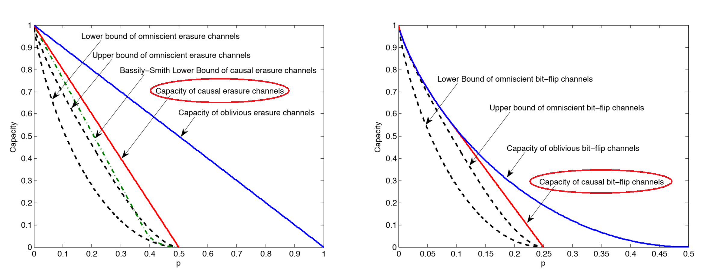
20
Causal adversaries
Capacity
(Chen, J, Langberg, STOC 2015)
“Sha-mming”

Slide 21
21
Causal adversaries
Between oblivious and omniscient adversaries
Analysis of all possible causal adversarial behaviours
1
One possible adversarial trajectory
(Slopes are bounded)
$$p_{t}$$
$$p$$
$$t$$
$$n$$

Slide 22
22
Causal adversaries
Analysis of all possible causal adversarial behaviours
Proof techniques overview - Converse: “Babble-and-push” attack
1
2
3
4
5
6
7
8
9
10
11
12
13
14
Transmitted Word
0
1
1
1
0
?
?
?
?
?
?
?
?
?
Tampered Word
0
1
0
1
1
Babbling phase
Pushing phase
Randomly tamper with $n\overline{p}$ bits

Slide 23
23
Causal adversaries
Proof techniques overview - Converse: “Babble-and-push” attack
Pushing phase
…
6
7
8
9
10
11
12
13
14
Construct a set of codewords based on corrupted bits transmitted so far
Select one codeword from the set and then “push” the transmitted codeword towards the selected one
Transmitted Word
…
0
0
1
0
1
1
0
1
1
Tampered Word
…
0
1
1
0
1
0
0
1
1
Selected Word
…
0
1
0
1
1
0
0
1
1
Pushing phase

Slide 24
24
Causal adversaries
Proof techniques overview - Converse: “Babble-and-push” attack
Pushing phase
…
6
7
8
9
10
11
12
13
14
Construct a set of codewords based on corrupted bits transmitted so far
Select one codeword from the set and then “push” the transmitted codeword towards the selected one
Transmitted Word
…
0
0
1
0
1
1
0
1
1
Tampered Word
…
0
1
1
0
1
0
0
1
1
Selected Word
…
0
1
0
1
1
0
0
1
1
Pushing phase
The tampered word lies in midway between the transmitted word and selected word.

Slide 25
25
Causal adversaries
Proof techniques overview - Converse: “Babble-and-push” attack
Plotkin bound: Binary code with d_{min} > n(1+ε)/2 has O(1/ε) codewords
Group of size $1/ε$

Slide 26
26
Causal adversaries
Proof techniques overview - Converse: “Babble-and-push” attack
Babbling phase
Pushing phase
1
2
3
4
5
6
7
8
9
10
11
12
13
14
Transmitted Word
0
1
1
1
0
?
?
?
?
?
?
?
?
?
Tampered Word
0
1
0
1
1
$$l$$
$$n−l$$
List-decoding condition
Energy-bounding condition
Shannon-capacity
of first l channel
uses
# message bits
remaining bit-flip
budget
Avg pairwise
distance (Plotkin)

Slide 27
27
Causal adversaries
Proof techniques overview - Converse: “Babble-and-push” attack
Using stochastic encoders instead of deterministic encoders illustrated in previous slides
Message

Slide 28
28
Causal adversaries
Proof techniques overview - Converse: “Babble-and-push” attack
Calvin won’t run out of his flipping budget
Imposing a probability of decoding error $O\left(ε^{1/ε}\right)$
Calvin

Slide 29
29
Causal adversaries
Proof techniques overview - Converse: “Babble-and-push” attack
Proof techniques overview – Achievability
1
Possible decoding points
$$p_{t}$$
Trajectory of the “babble-and-push strategy”
$$p$$
$$t$$
$$n$$

Slide 30
30
Causal adversaries
Proof techniques overview - Converse: “Babble-and-push” attack
Proof techniques overview – Achievability
Encoder: concatenated stochastic codes
$$m$$
$$s_{1}$$
$$C_{1}(m,s_{1})$$
code $C_{1}$
$nR$ bits
$nS$ bits
$nθ$ bits

Slide 31
31
Causal adversaries
Proof techniques overview – Achievability
Encoder: concatenated stochastic codes
$$m$$
$$s_{1}$$
$$C_{1}(m,s_{1})$$
$$C_{1}(m,s_{1})$$
$$C_{2}(m,s_{2})$$
code $C_{1}$
$$C_{1/θ}(m,s_{1/θ})$$
$nR$ bits
$nS$ bits
$nθ$ bits
$n$ bits

Slide 32
32
Causal adversaries
Proof techniques overview – Achievability
Encoder: concatenated stochastic codes
Decoding process: list-decoding + unique decoding
$$C_{1}(m,s_{1})$$
$$C_{1}(m,s_{1})$$
$$C_{2}(m,s_{2})$$
$$C_{2}(m,s_{2})$$
$$C_{t}(m,s_{t})$$
$$C_{t}(m,s_{t})$$
$$C_{1/θ}(m,s_{1/θ})$$
$tnθ$ bits
List-decoding phase
Unique decoding phase
Obtain a list of messages

Slide 33
33
Causal adversaries
Proof techniques overview – Achievability
Encoder: concatenated stochastic codes
Decoding process: list-decoding + unique decoding
If two words differ in a limited number of positions, they are said to be consistent.
$$C_{1}(m,s_{1})$$
$$C_{2}(m,s_{2})$$
$$C_{t}(m,s_{t})$$
$$C_{1/θ}(m,s_{1/θ})$$
$tnθ$ bits
List-decoding phase
Unique decoding phase
Consistency Checking
Obtain a list of messages
Encodings

Slide 34
34
Causal adversaries
Proof techniques overview – Achievability
Encoder: concatenated stochastic codes
Decoding process: list-decoding + unique decoding
List of “right mega sub-codewords”
Received “right mega sub-codeword”
Fails consistency checking…

Slide 35
35
Causal adversaries
Proof techniques overview – Achievability
Encoder: concatenated stochastic codes
Decoding process: list-decoding + unique decoding
With high probability, Bob succeeds in decoding
Received “right mega sub-codeword”
Passes consistency checking!

Slide 36
36
Summary (Chen, J, Langberg STOC 2015)
Binary Erasures
Binary Bit-flips

Slide 37
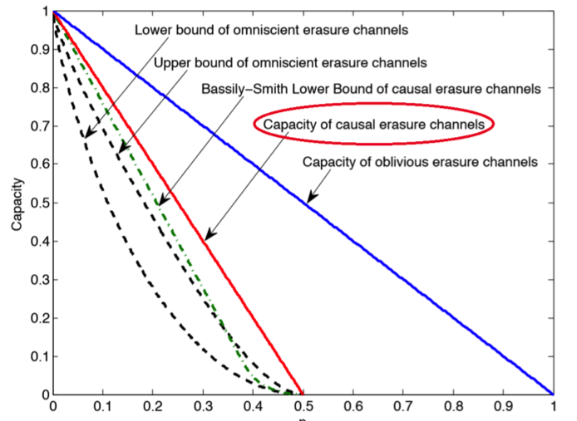
37
Sneak Previews
(Chen, Jaggi, Langberg, ISIT2016) q-ary online p*-erasure p-error channels
(Dey, Jaggi, Langberg, Sarwate ISIT2016) one-bit delay p*-erasure channels
Stochastic encoding
Deterministic encoding

Slide 38
0101001011001011001011000101000101001010110
0101001011001011001011000101000101001010110
Coherence.pptx
Coherence.pptx
Coherence.pptx
. . .
0101001011001011001011000101000101001010110

Slide 39
q₁ q₂ q₃ q₄ q₅ q₅ q₄ q₃ q₂ q₁ q₁ q₂ q₃ q₄ q₅ q₅ q₄ q₃ q₂ q₁ q₁ q₂ q₃ q₄ q₅
q₂ q₄ q₅ q₁ q₃ q₁ q₂ q₃ q₄ q₅ q₃ q₂ q₁ q₅ q₄ q₅ q₂ q₃ q₁ q₂ q₃ q₅ q₂ q₃ q₁
Notes:
An example demonstrating two codewordscoherence over ${\cal T}$ for two base codewords $\bu(m)$ and $\bu(m’)$. Let ${\cal T} = [25]$, {\it i.e.}, it comprises of the first $25$ locations of each codeword, and let there be $K=5$ noise-levels $q_1,\ldots,q_5$ for each codeword, in the sets of locations $S(m,1),\ldots,S(m,5)$ and $S(m’,1),\ldots,S(m’,5)$ respectively. The expected size of each $V(m,m’,k,k’)$ is therefore $|{\cal T}|/K^2 = 1$. It can be verified that the largest size of $V(m,m’,k,k)$ is $2$ (only for $k = 3$ -- all other sets of size at least $2$ have $k\neq k’$), and hence $\bu(m)$ and $\bu(m’)$ are at most $2$-coherent over ${\cal T}$. Further, there are exactly $4$ locations in which $\bu(m)$ and $\bu(m’)$ are coherent (the $8$th, $12$th, $16$th and $18$th locations, as highlighted in this figure), so the remaining $21$ decoherent locations are potentially usable by the decoder Bob, to disambiguate between $m$ and $m’$. In this example, $V(m,m’,1,2)$ comprising of the two locations $\{1,20\}$ is a possible choice for the disambiguation set, being of ``reasonable size’’, and being the lexicographically first set with $k \neq k’$.

Slide 40
Erasures
1 0 0 1 0 1 0 1 1
Erasing branch-points
Erasing disambiguity

Slide 41
41
Other related models
Limited-view adversaries:
Multipath networks with large-alphabet symbols
Adversary can see a certain fraction and jam another fraction
ITW 2015,
ISIT 2015
Myopic adversaries:
Adversary has (non-causal) view of a noisy version of Alice's transmission
ISIT 2015

Slide 42
Questions?

