Slide 1
An Advantage of Estimating Mutual Information through Entropies
Chung Chan (chung.chan@cityu.edu.hk)
Joint work with Ali Al-Bashabsheh, Hing Pang Huang, Michael Lim, Da Sun Handason Tam, Chao Zhao

Slide 2
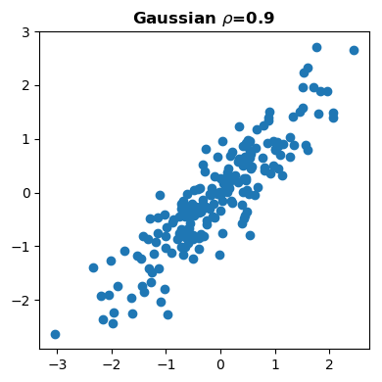
Problem formulation
Given $\left(X_{1},Y_{1}\right),\left(X_{2},Y_{2}\right)…,\left(X_{N}, Y_{N}\right)\sim P_{XY}$ where $X$ and $Y$ are random vectors with unknown pdf $p_{XY}$.
Estimate the mutual information (MI)
$$I\left(X∧Y\right)≔D(P_{XY}||P_{X}P_{Y})$$
$$=E\left[\ln{\frac{p_{XY}(X,Y)}{p_{X}(X)p_{Y}(Y)}}\right]$$
$$≈\frac{1}{N}\sum_{j=1}^{N}{i_{XY}(X_{j},Y_{j}) }$$
How to estimate $i_{XY}$?
$$y$$
$$i_{XY}(X,Y)$$
$$x$$

Slide 3
Density-based estimation
Estimate $i_{XY}$ by estimating $p_{XY}$:
Binning [Paninski 03]
Kernel [Moon et al. 95]
Nearest neighbor [Kraskov et al. 04]
Is there a truly non-parametric estimation?
Neural estimations [Poole et al. 18]
$$y$$
$$x$$

Slide 4
Mutual Information Neural Estimation (MINE) [Belghazi et al. 18]
$$\left(x,y\right)$$
$$y$$
Neural network
$$x$$
data samples $∼P_{XY}$
Pull up on data samples
$$i_{XY}\left(x,y\right)=\ln{\frac{p_{XY}\left(x,y\right)}{p_{X}{\left(x\right)p}_{Y}\left(y\right)}}$$
resampling
$$f\left(x,y\right)$$
ref. samples $∼P_{X}P_{Y}$
Push down on ref. samples
discriminator for
data vs reference
Without access to the ground truth, how to choose the loss function?

Slide 5
Variational formula for divergence [Donsker & Varadhan, 1983]
$$=E\left[\ln{\frac{p_{Z}(Z)}{p_{Z^{′}}(Z)}}\right]+c$$
$$D(P_{Z}|\left|P_{Z^{′}}\right)=\sup_{f:𝒵↦ℝ}\left\{E\left[f\left(Z\right)\right]−\ln{E\left[e^{f\left(Z^{′}\right)}\right]}\right\}$$
Optimal solution: $f\left(z\right)=\ln{\frac{p_{Z}(z)}{p_{Z^{′}}(z)}}+c$
$$E\left[\frac{p_{Z}\left(Z^{′}\right)}{p_{Z^{′}}\left(Z^{′}\right)}\right]×c$$
$$1$$

Slide 6
MINE Loss function for gradient descent [Belghazi et.al., 2018]
$$≈\frac{1}{N}\sum_{j=1}^{N}{f(X_{j},Y_{j}) }$$
$$\text{With} Z=\left(X,Y\right)∼P_{XY} \text{and} Z^{′}=\left(X^{′},Y^{′}\right)∼P_{X}P_{Y}\text{.}$$
Pull up on data samples
$$D(P_{Z}|\left|P_{Z^{′}}\right)=\sup_{f:𝒵↦ℝ}\left\{E\left[f\left(Z\right)\right]−\ln{E\left[e^{f\left(Z^{′}\right)}\right]}\right\}$$
Optimal solution: $f\left(z\right)=\ln{\frac{p_{Z}(z)}{p_{Z^{′}}(z)}}+c$
Loss function: $L\left(f\right)≔−\frac{1}{N}\sum_{j=1}^{N}{f\left(X_{j},Y_{j}\right) }+\ln{\frac{1}{N^{′}}\sum_{j=1}^{N^{′}}{e^{f(X_{j}^{′},Y_{j}^{′})} }}$
$$I\left(X∧Y\right)$$
$$≈\frac{1}{N^{′}}\sum_{j=1}^{N^{′}}{e^{f(X_{j}^{′},Y_{j}^{′})} }$$
Push down on ref. samples
$$i_{XY}(x,y)$$
Cause bias

Slide 7
Variational formula for divergence Short proof
$≥0$ with $=$ iff $P_{\hat{Z}}=P_{Z}$
$D( P_{Z}|\left| P_{Z′}\right)$ $=D( P_{Z}|\left| P_{Z′}\right)−{\inf_{p_{\hat{Z}} ∈ 𝒫\left(𝒵\right)}{D( P_{Z}|\left| P_{\hat{Z}}\right)}}_{ }$
$=\sup_{P_{\hat{Z}} ∈ 𝒫\left(𝒵\right)}{E\left[\ln{\frac{p_{Z}\left(Z\right)}{p_{Z^{′}}\left(Z\right)}\frac{p_{\hat{Z}}\left(Z\right)}{p_{Z}\left(Z\right)}}\right]}$
$=\sup_{P_{\hat{Z}} ∈ 𝒫\left(\text{𝒵}\right)}{E\left[\ln{\frac{p_{\hat{Z}}\left(Z\right)}{p_{Z^{′}}\left(Z\right)}}\right]}$
$=\sup_{f:𝒵↦ℝ}\left\{E\left[f\left(Z\right)\right]−\ln{E\left[e^{f\left(Z^{′}\right)}\right]}\right\}$
$$∵D(P_{Z}|\left|P_{Z^{′}}\right)=E\left[\ln{\frac{p_{Z}\left(Z\right)}{p_{Z^{′}}\left(Z\right)}}\right]$$
non-negative
$$\frac{1}{E\left[e^{f\left(Z^{′}\right)}\right]}$$
$$=f\left(Z\right)$$
$$−\ln{E\left[e^{f\left(Z^{′}\right)}\right]}$$
with $p_{\hat{Z}}\left(z\right)≔p_{Z^{′}}\left(z\right)e^{f\left(z\right)}$
normalize

Slide 8
Variational formula for divergence General proof by Fenchel-Legendre transform [Ruderman et al. 2016]
$$=\int_{𝒵}{\left(r\ln{r}\right)⋅p_{Z^{′}}dz}$$
$$G\left[r\right]≔E\left[r\left(Z^{′}\right)\ln{r\left(Z^{′}\right)}\right]$$
strictly convex functional
tangent
$$G\left[\frac{p_{Z}}{p_{Z^{′}}}\right]=E\left[\frac{p_{Z}}{p_{Z^{′}}}\ln{\frac{p_{Z}}{p_{Z^{′}}} }\right]=D\left(P_{Z}||P_{Z^{′}}\right)$$
Lower bound
$$E\left[f(Z)\right]−G^{∗}\left[f\right]$$
$$r$$
$$=\sup_{f:𝒵↦ℝ}\left\{E\left[f\left(Z\right)\right]−G^{∗}[f]\right\}$$
$$\frac{p_{Z}}{p_{Z^{′}}}$$
$$r^{∗}$$
$${\left.\int_{Z}{r⋅f⋅p_{Z^{′}}dz}\right|}_{r=\frac{p_{Z}}{p_{Z^{′}}}}$$
$$={\left.E[r\left(Z^{′}\right)f(Z^{′})]\right|}_{r=\frac{p_{Z}}{p_{Z^{′}}}}=$$
$$=\sup_{f:𝒵↦ℝ}\left\{E\left[f\left(Z\right)\right]−\ln{E\left[e^{f\left(Z^{′}\right)}\right]}\right\}$$
$$f⋅p_{Z^{′}}dz$$
$$E[f\left(Z\right)]$$
$$G^{∗}\left[f\right]=E\left[f\left(Z^{′}\right)r^{∗}\left(Z^{′}\right)\right] −G\left[r^{∗}\right]$$
$y$-intercept
$$=\sup_{\begin{aligned}r:𝒵↦ℝ_{+} \\ E\left[r\left(Z^{′}\right)\right]=1\end{aligned}}\left\{E\left[f\left(Z^{′}\right)r\left(Z^{′}\right)\right] −G\left[r\right]\right\}=\ln{E\left[e^{f\left(Z^{′}\right)}\right]}$$
$$−G^{∗}\left[f\right]$$

Slide 9
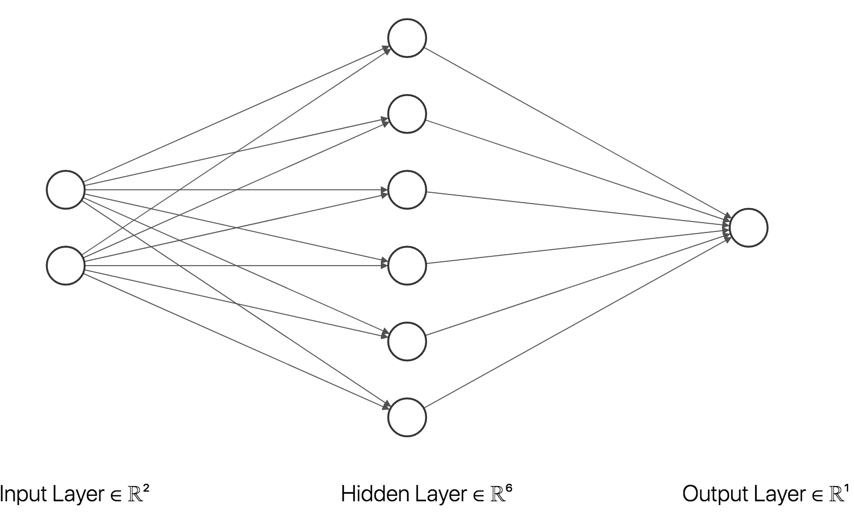
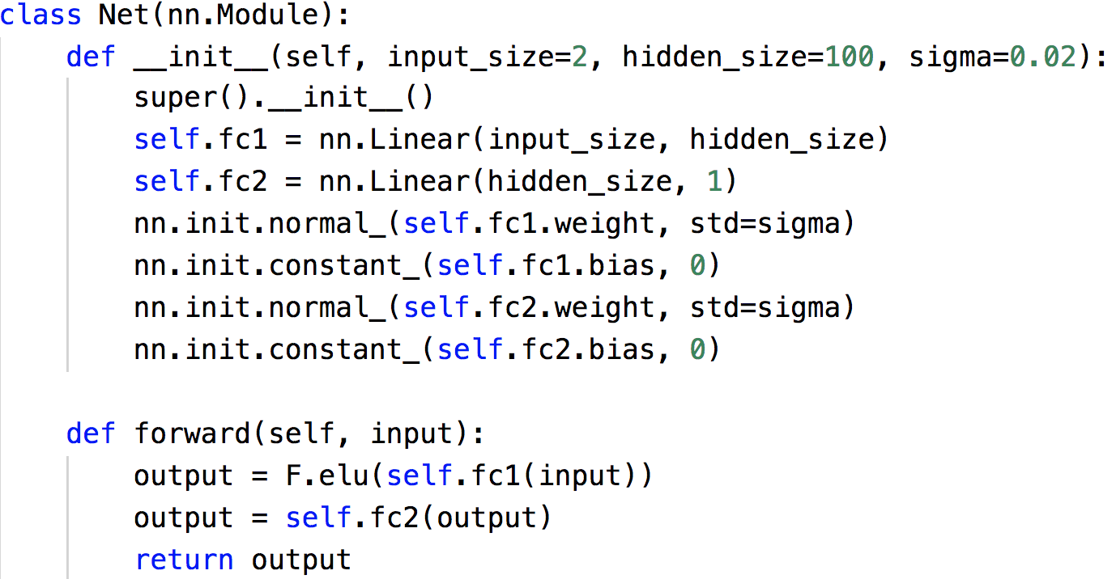
MINE PyTorch code
$$I\left(X∧Y\right)≔−\inf_{f:Z↦ℝ}{L\left(f\right)}, where L\left(f\right)≔−\frac{1}{N}\sum_{j=1}^{N}{f\left(X_{j},Y_{j}\right) }+\ln{\frac{1}{N^{′}}\sum_{j=1}^{N^{′}}{e^{f(X_{j}^{′},Y_{j}^{′})} }}$$

Slide 10
Experiment setup
$p_{XY}(x,y)=𝒩_{\left[\begin{matrix}x \\ y\end{matrix}\right]}\left(0, \left[\begin{matrix}1 & ρ \\ ρ & 1\end{matrix}\right]\right)$ with $ρ=0.9$.
Sample size = 1000

Slide 11
Result after 200 Iterations
$$i_{XY}$$
$$f$$

Slide 12
Result after 400 Iterations
$$i_{XY}$$
$$f$$

Slide 13
Result after 800 Iterations
$$i_{XY}$$
$$f$$

Slide 14
Converged after 1600 Iterations
$$i_{XY}$$
$$f$$

Slide 15
Same after 3200 Iterations
$$i_{XY}$$
$$f$$

Slide 16
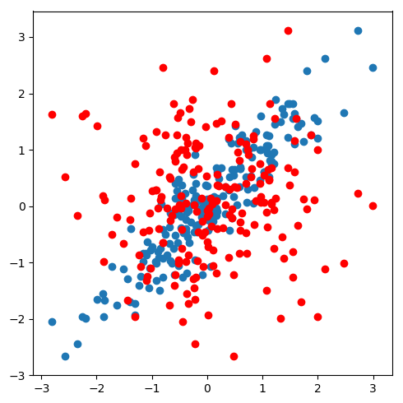
Variations with repeated runs

Slide 17
Issue of slow convergence
Converged?
$$0.4$$
$$0.4$$
$$0.3$$
$$0.3$$
MI estimate
MI estimate
Converged?
$$0.2$$
$$0.2$$
$$0.1$$
$$0.1$$
Nothing to learn?
$$0.0$$
$$0.0$$
$$0$$
$$10$$
$$20$$
$$30$$
$$40$$
$$50$$
$$60$$
$$70$$
$$80$$
$$90$$
$$100$$
$$0$$
$$10$$
$$20$$
$$30$$
$$40$$
$$50$$
$$60$$
$$70$$
$$80$$
$$90$$
$$100$$
${10}^{3}$ iteractions
${10}^{3}$ iterations

Slide 18
Contributions
Obtain a simple example where MINE exhibits slow staircase convergence.
Give an intuitive explanation of when and why the problem occurs.
Propose a remedy: MI-NEE (Mutual Information Neural Entropic Estimation).

Slide 19
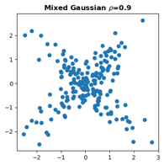
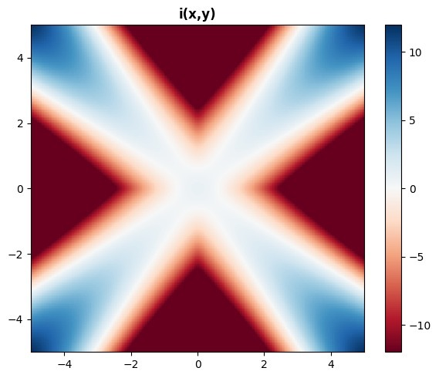
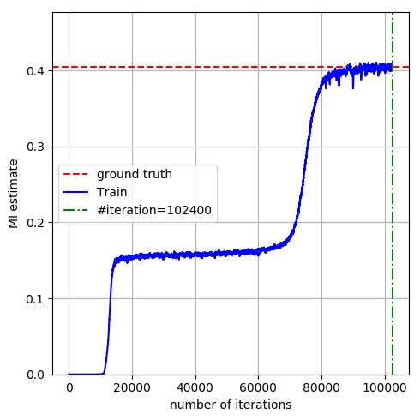
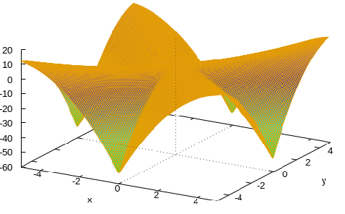
The example
$$p_{XY}\left(x,y\right)=\frac{1}{2}𝒩_{\left[\begin{matrix}x \\ y\end{matrix}\right]}\left(0, \left[\begin{matrix}1 & ρ \\ ρ & 1\end{matrix}\right]\right)+\frac{1}{2}𝒩_{\left[\begin{matrix}x \\ y\end{matrix}\right]}\left(0, \left[\begin{matrix}1 & −ρ \\ −ρ & 1\end{matrix}\right]\right), \text{with} ρ=0.9$$
problem of overlapping modes
Why a slow start?
quite flat
data samples and ref samples look similar, especially in the dense region around the origin.

Slide 20
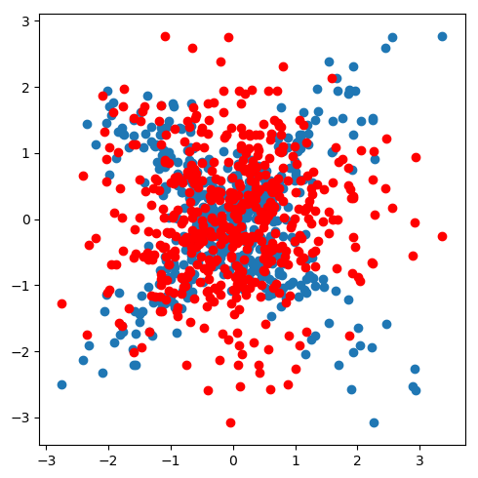
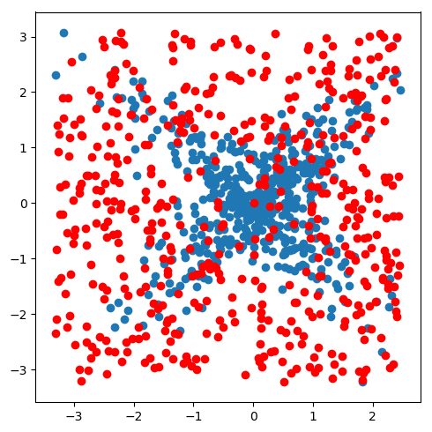
MI-NEE Entropy estimation with a custom reference
cross entropy: $≈\frac{1}{N}\sum_{j=1}^{N}{\text{ln}\frac{1}{p_{X^{′}Y^{′}}(X_{j},Y_{j})}}$
$$H(X,Y)=E\left[\ln{\frac{1}{p_{X Y} (X,Y)}}\right]$$
$$H(X,Y)=E\left[\ln{\frac{1}{p_{X^{′}Y^{′}}(X,Y)}}\right]−E\left[\ln{\frac{p_{XY}(X,Y)}{p_{X^{′}Y^{′}}(X,Y)}}\right]$$
$$I\left(X∧Y\right)=H\left(X\right)+H\left(Y\right)−H(X,Y)$$
Can be estimated similarly and faster
$$D(P_{XY}||P_{X}P_{Y})$$
$$D\left(P_{XY}||P_{X^{′}Y^{′}}\right)$$
known reference distribution

Slide 21
MI-NEE Loss function
$$I\left(X∧Y\right)=$$
$$−H\left(X,Y\right)$$
$$+H\left(X\right)$$
$$+H\left(Y\right)$$
$$−E\left[\ln{\frac{1}{p_{X^{′}Y^{′}}(X,Y)}}\right]$$
$$+E\left[\ln{\frac{1}{p_{X^{′}}(X)}}\right]$$
$$+E\left[\ln{\frac{1}{p_{Y^{′}}(Y)}}\right]$$
$$=$$
$$+D\left(p_{XY}||p_{X^{′}Y^{′}}\right)$$
$$−D\left(p_{X}||p_{X^{′}}\right)$$
$$−D\left(p_{Y}||p_{Y^{′}}\right)$$
with $p_{X^{′}Y^{′}}=p_{X^{′}}p_{Y^{′}}$
$$=$$
$$\sup_{f_{0}}\left\{E\left[f_{0}\left(X,Y\right)\right]−\ln{E\left[e^{f_{0}\left(X^{′},Y^{′}\right)}\right]}\right\}$$
$$−\sup_{f_{1}}\left\{E\left[f_{1}\left(X\right)\right]−\ln{E\left[e^{f_{1}\left(X^{′}\right)}\right]}\right\}$$
$$−\sup_{f_{2}}\left\{E\left[f_{2}\left(Y\right)\right]−\ln{E\left[e^{f_{2}\left(Y^{′}\right)}\right]}\right\}$$
$$≈\frac{1}{N}\sum_{j=1}^{N}{f_{0}(X_{j},Y_{j}) }$$
$$≈\frac{1}{N^{′}}\sum_{j=1}^{N^{′}}{e^{f_{0}(X_{j}^{′},Y_{j}^{′})} }$$
What if $p_{X^{′}Y^{′}}=p_{X}p_{Y}$?
MINE is a special case.
Unlike MINE, $N′$ can be arbitrarily large as $p_{X^{′}Y^{′}}$ is known.
less bias due to consistency

Slide 22
MI-NEE Uniform reference
$$p_{X^{′}Y^{′}}\left(x,y\right)≔\left\{\begin{aligned}\frac{1}{\text{vol}(B)}, \left(x,y\right)∈B \\ 0, \text{otherwise}\end{aligned}\right., \text{where}$$
$B$ is the bounding box of $\left(X_{1}, Y_{1}\right),…,(X_{N},Y_{N})$.

Slide 23
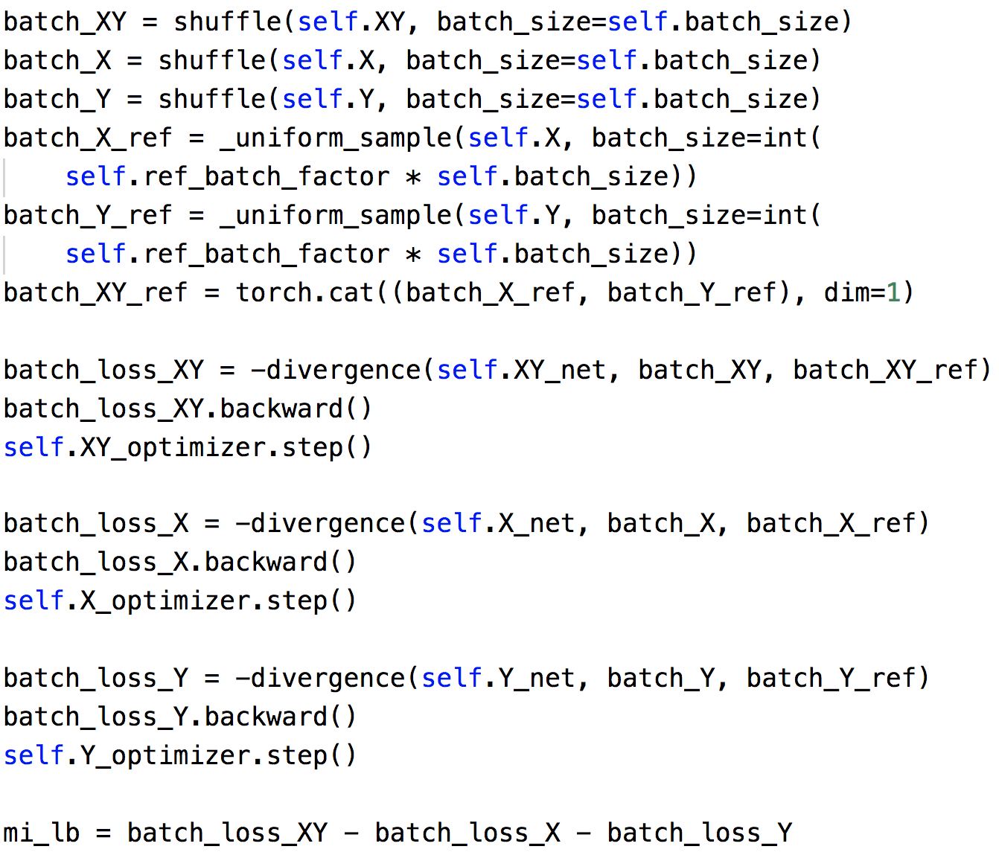
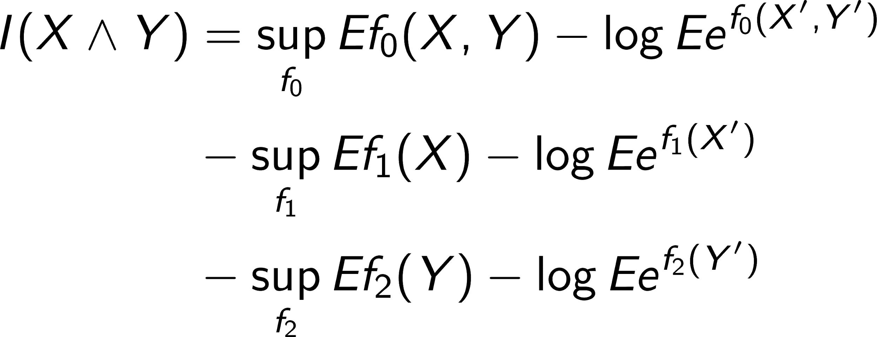
MINEE PyTorch code

Slide 24
Experiment with Mixed Gaussian
$p_{XY}(x,y) =\frac{1}{2}𝒩_{\left[\begin{matrix}x \\ y\end{matrix}\right]}\left(0, \left[\begin{matrix}1 & ρ \\ ρ & 1\end{matrix}\right]\right)+\frac{1}{2}𝒩_{\left[\begin{matrix}x \\ y\end{matrix}\right]}\left(0, \left[\begin{matrix}1 & −ρ \\ −ρ & 1\end{matrix}\right]\right), \text{with} ρ=0.9$
Sample size = 1000

Slide 25
 | MINE | MI-NEE

Slide 26
 | MINE | MI-NEE

Slide 27
 | MINE | MI-NEE

Slide 28
 | MINE | MI-NEE

Slide 29
 | MINE | MI-NEE

Slide 30
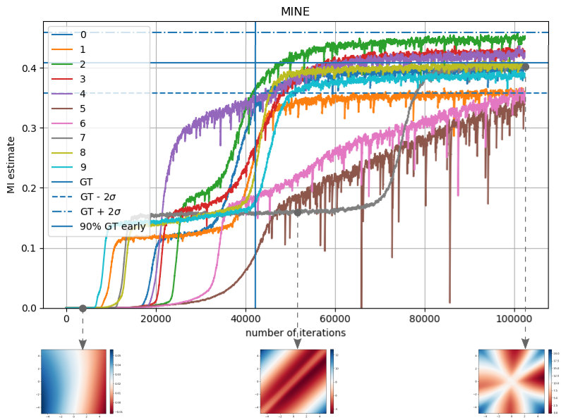
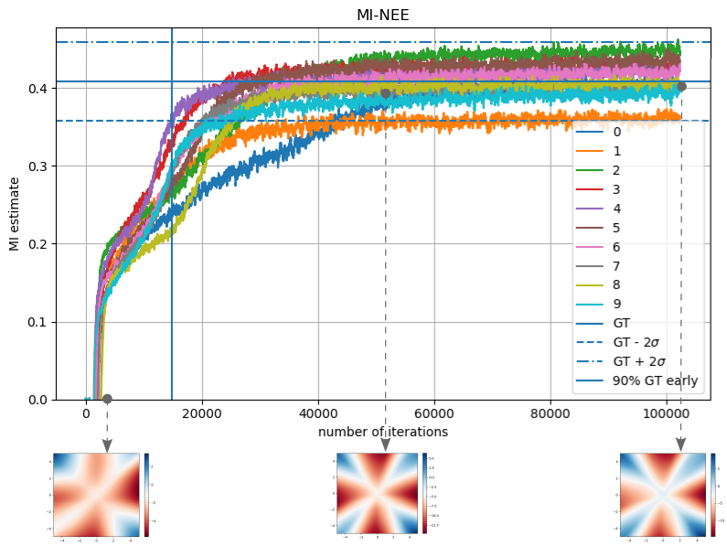
Variations with repeated runs

Slide 31
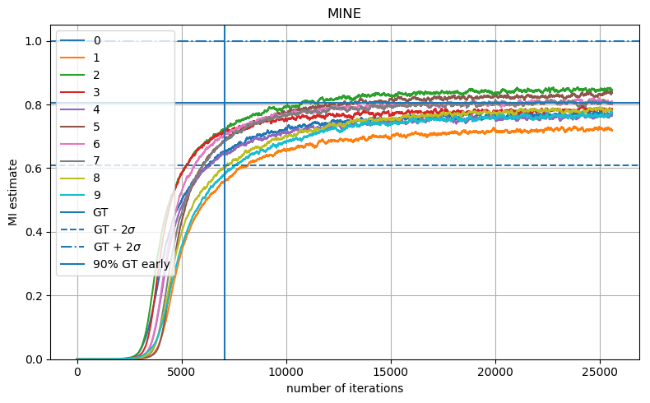
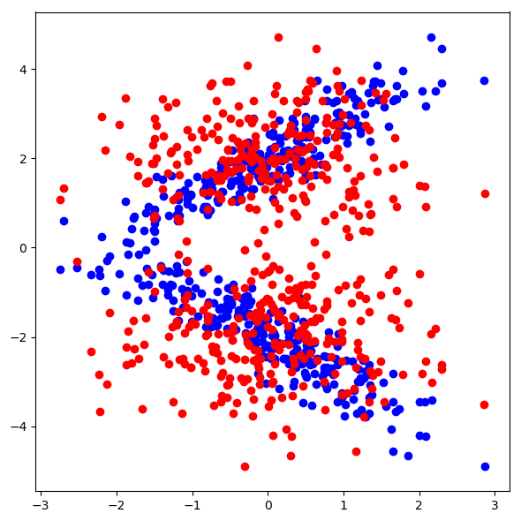
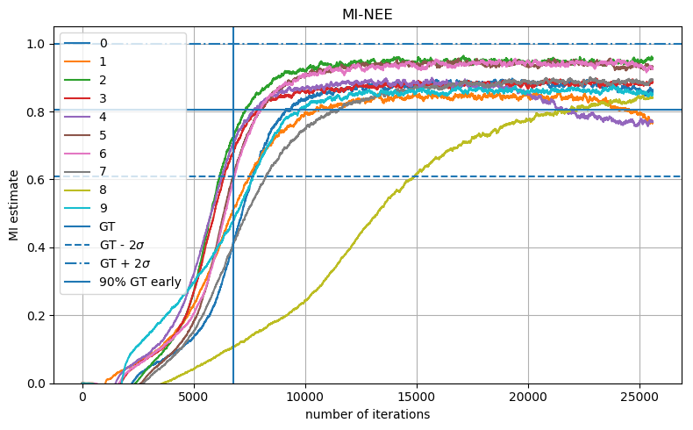
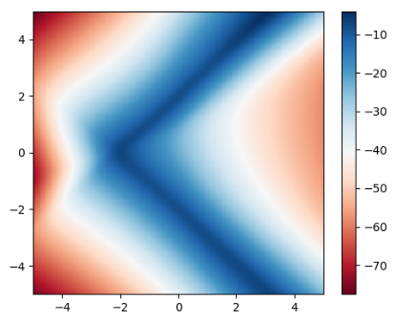
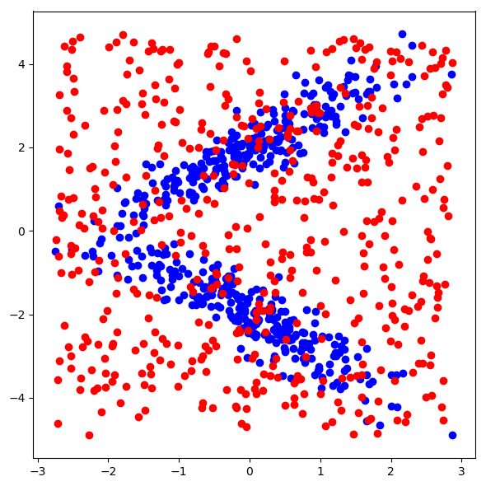
What if the modes do not overlap?
$p_{XY}(x,y) =\frac{1}{2}𝒩_{\left[\begin{matrix}x \\ y\end{matrix}\right]}\left(\left[\begin{matrix}0 \\ 2\end{matrix}\right], \left[\begin{matrix}1 & ρ \\ ρ & 1\end{matrix}\right]\right)+\frac{1}{2}𝒩_{\left[\begin{matrix}x \\ y\end{matrix}\right]}\left(\left[\begin{matrix}0 \\ − 2\end{matrix}\right], \left[\begin{matrix}1 & −ρ \\ −ρ & 1\end{matrix}\right]\right), \text{with} ρ=0.9$
Sample size = 1000

Slide 32
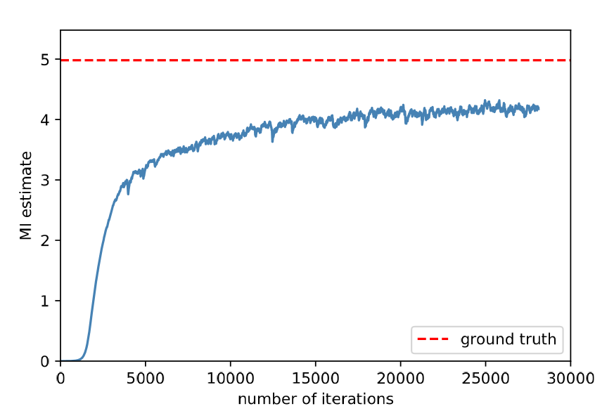
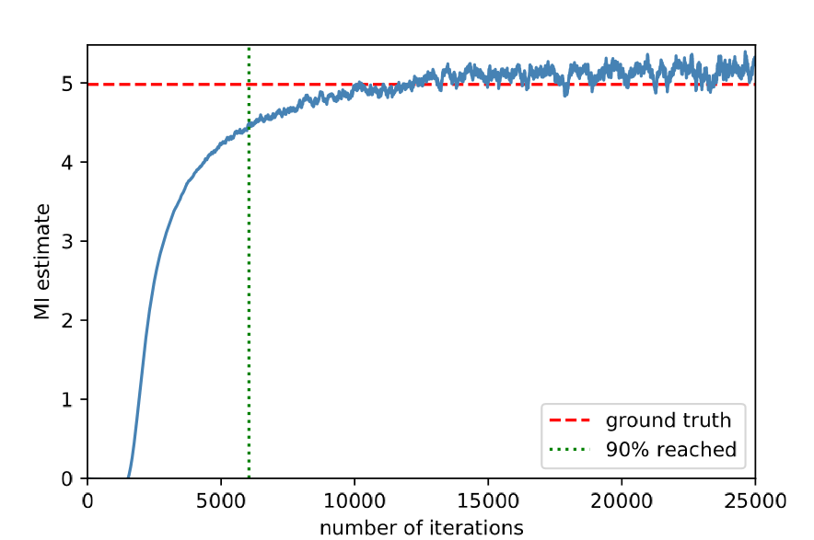
Higher dimensional case
$d$ independent pairs of gaussian:
$$p_{XY}\left(x,y\right)=\prod_{j=1}^{d}{𝒩_{\left[\begin{matrix}x_{j} \\ y_{j}\end{matrix}\right]}\left(0, \left[\begin{matrix}1 & ρ \\ ρ & 1\end{matrix}\right]\right)}, \text{with} d=6, ρ=0.9$$
MINE
MI-NEE

Slide 33
Something wrong? Bounded support of uniform reference
$$p_{X^{′}Y^{′}}\left(x,y\right)≔\left\{\begin{aligned}\frac{1}{\text{vol}(B)}, \left(x,y\right)∈B \\ 0, \text{otherwise}\end{aligned}\right., \text{where}$$
$B$ is the bounding box of $\left(X_{1}, Y_{1}\right),…,(X_{N},Y_{N})$.
Technicality:
$$D\left(P_{XY}||P_{X^{′}Y^{′}}\right)=∞ if p_{XY}\left(B\right)<1.$$
$$H(X,Y)=E\left[\ln{\frac{1}{p_{X^{′}Y^{′}}(X,Y)}}\right]−E\left[\ln{\frac{p_{XY}(X,Y)}{p_{X^{′}Y^{′}}(X,Y)}}\right]$$
undefined
$$=∞$$
$$=∞$$

Slide 34
What MI-NEE actually computes
$I\left(\tilde{X}∧\tilde{Y}\right), where$
$p_{\tilde{X}\tilde{Y}}\left(x,y\right)≔p_{XY|\left(X,Y\right)∈B}\left(x,y\right)$ $$=\left\{\begin{aligned}\frac{p_{XY}(x,y)}{P_{XY}(B)}, \left(x,y\right)∈B \\ 0, \text{otherwise}\end{aligned}\right.$$
As $N→∞$:
$\left(X_{1}, Y_{1}\right),…,(X_{N},Y_{N})$ are approximately i.i.d. samples of $(\tilde{X},\tilde{Y})$.
$I\left(X∧Y\right)≈I(\tilde{X}∧\tilde{Y})$

Slide 35
Conclusions
Identified the issue of overlapping modes that slows down the training of MINE.
Proposed an improvement (MI-NEE) that uses a custom reference distribution to sample at the regions of interest.
GitHub repository with Jupyter notebook demos: https://github.com/ccha23/MI-NEE

Slide 36
Extension #1 Discrete random variables
$X$ is a continuous input feature from $ℝ^{m}$
$Y$ is a discrete class label from $\{1,…,k\}$
$$x∈ℝ^{m}$$
Neural network
$$…$$
$$f\left(x,1\right)∈ℝ$$
$$f\left(x,k\right)∈ℝ$$

Slide 37
Extension #2 Variational formula for generalized notion of entropy
$$H_{m,g}\left(Z\right)≔−m\left(E\left[g\left(p_{Z}\left(Z\right)\right)\right]\right), \text{where}$$
$g$: strictly convex and lower semi-continuous,
$m$: strictly increasing and lower semi-continuous.
Gives Rényi Entropy with $g(r)=\left\{\begin{aligned}r^{α−1}, α>1 \\ r^{1−α}, α∈[0,1)\end{aligned}\right.$ and $m\left(r\right)=\frac{1}{\left|α−1\right|}\ln\left(r\right)$.
Variational formula: $H_{m,g}\left(Z\right)=−\sup_{f:𝒵→ℝ}m\left(E\left[f\left(Z\right)\right]−G^{∗}\left[f\right]\right), \text{where}$ $G^{∗}\left[f\right]≔\sup_{r:𝒵→ℝ}{\int_{𝒵}{\left[f⋅r−g∘r\right]dz}}.$
Optimal solution is $f(z)=(∂g)(p_{Z}\left(z\right))$, unique if $g$ is differentiable.
Similar to $f$-divergences [Nguyen et al. 10] [Ruderman et al. 12]

Slide 38
Extension #3 Conditional entropy estimation for classification
$$H_{m,g}\left(Y|X\right)≔−m\left(E\left[g\left(p_{Y|X}\left(Y|X\right)\right)\right]\right)$$
Optimal solution $f(x,y)=(∂g)(p_{Y|X}\left(y|x\right))$.
Classifier:
$$\hat{y}=\arg{\max_{y}{f(x,y)}}$$
$$=\arg{\max_{y}{p_{Y|X}\left(y|x\right)}}$$
Similar to $f$-GAN that trains a discriminator [Nowozin et al. 16]
Similar to the conditional entropy maximization for InfoGAN [Chen et al. 16]

Slide 39
Extension #4 Parallelization
With $𝒵=\bigcup_{i=1}^{∞}{𝒵_{i}}$, ${\tilde{Z}}_{i}\sim P_{Z|Z∈𝒵_{i}}$ and ${\tilde{Z}}_{i}^{′}\sim P_{Z^{′}|Z^{′}∈𝒵_{i}}$,
$$D\left( \left.P_{Z} \right\|P_{Z^{′}}\right)=\sum_{i=1}^{∞}{P_{Z}\left(𝒵_{i}\right)\left[D\left( \left.P_{{\tilde{Z}}_{i}}\right\|P_{{\tilde{Z}}_{i}^{′}}\right)+\ln{\frac{P_{{\tilde{Z}}_{i}}\left(𝒵_{i}\right)}{P_{{\tilde{Z}}_{i}^{′}}\left(𝒵_{i}\right)}}\right]}$$
estimated by counting data samples in $𝒵_{i}$
estimated by neural network

Slide 40
References
[Donsker & Varadhan 83] "Asymptotic evaluation of certain Markov process expectations for large time. IV." Communications on Pure and Applied Mathematics (1983).
[Moon et al. 95] "Estimation of mutual information using kernel density estimators." Physical Review (1995).
[Paninski 03] "Estimation of entropy and mutual information." Neural computation (2003).
[Kraskov et al. 04] "Estimating mutual information." Physical review (2004).
[Nguyen et al. 10] "Estimating divergence functionals and the likelihood ratio by convex risk minimization." IEEE Transactions on Information Theory 56.11 (2010): 5847-5861.
[Ruderman et al. 12] “Tighter variational representations of f-divergences via restriction to probability measures.” arXiv preprint arXiv:1206.4664 (2012).
[Chen et al. 16] "InfoGAN: Interpretable representation learning by information maximizing generative adversarial nets." Advances in neural information processing systems. 2016.
[Nowozin et al. 16] "f-GAN: Training generative neural samplers using variational divergence minimization." Advances in neural information processing systems. 2016.
[Belghazi et al. 18] "MINE: mutual information neural estimation." arXiv preprint arXiv:1801.04062 (2018).
[Poole et al. 18] "On variational lower bounds of mutual information." In NeurIPS Workshop on Bayesian Deep Learning (2018).

